Slide 1
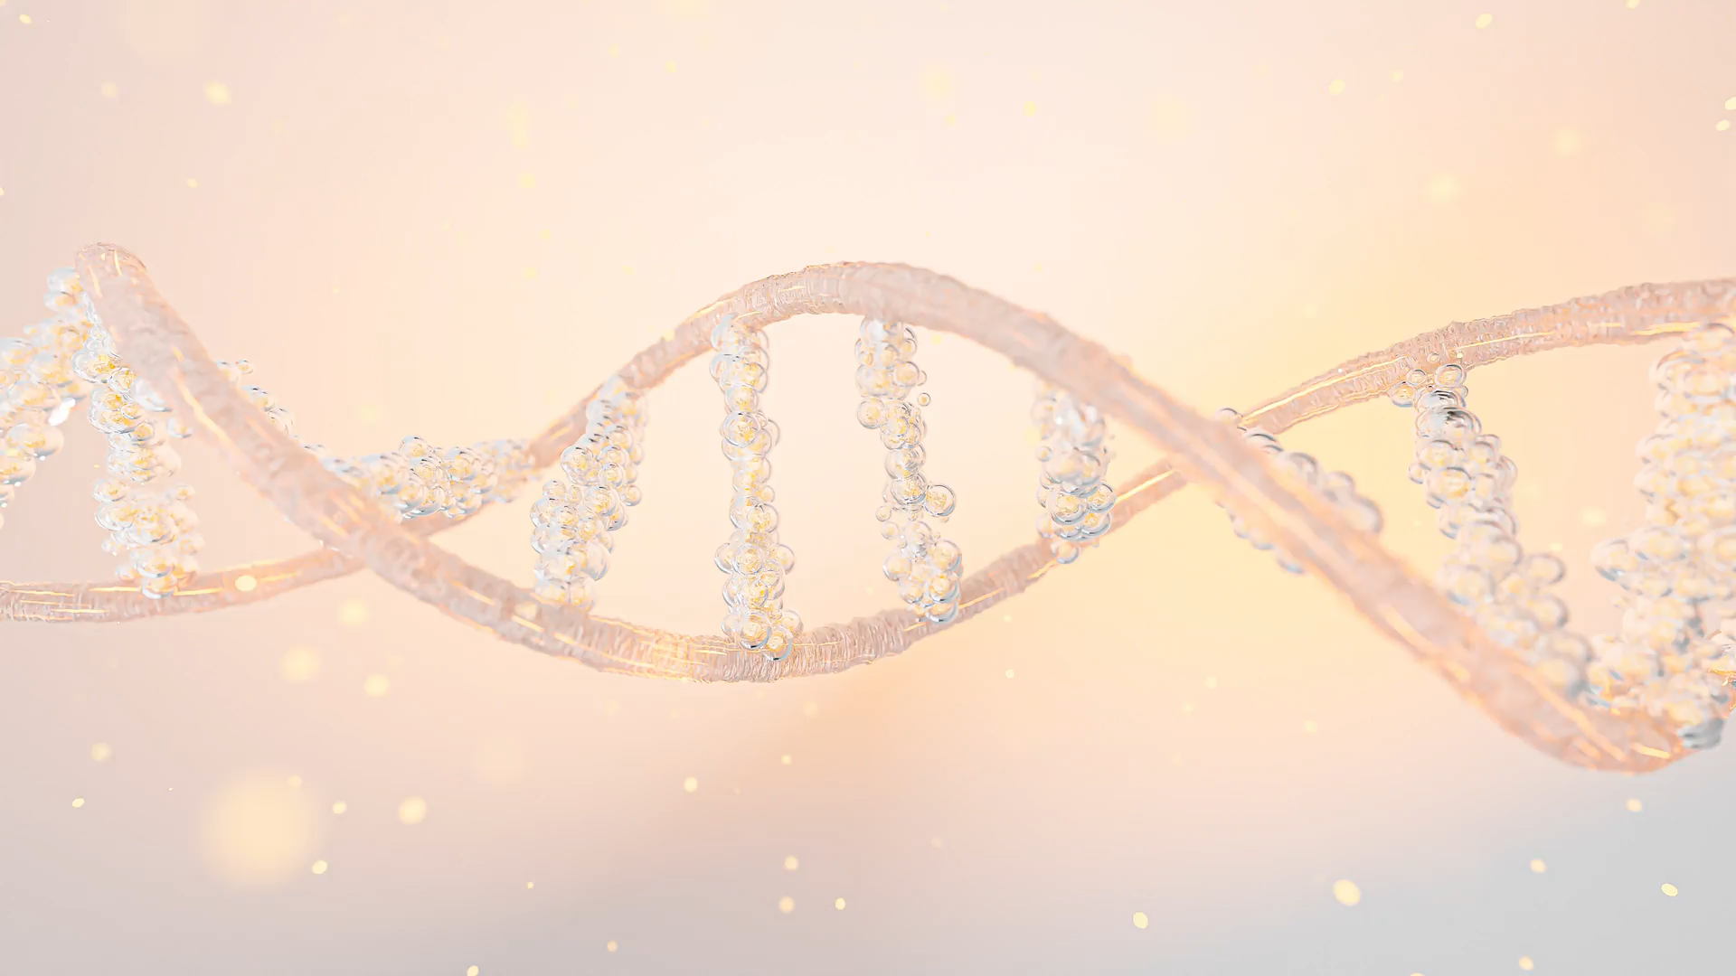
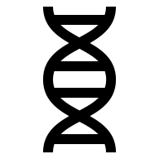
Genomic foundations
Paweł Dąbrowski-Tumański
MiNI Lecture, Fall 2025

Slide 2


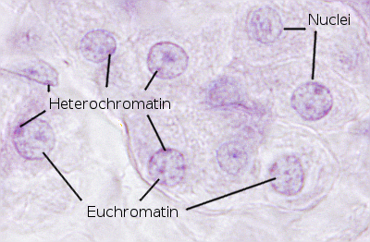
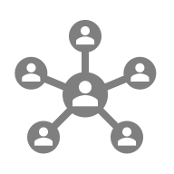




CHROMATIN
Notes:
Let's begin by examining the layers of genomic regulation. At the core is the
DNA sequence, the blueprint of life. But DNA alone is not enough; it is packaged
in chromatin, whose modi cations determine accessibility and gene expression.
RNA serves as the messenger, translating DNA instructions into proteins, the
functional molecules executing cellular processes.
As IT students, you might think of this as a multi-layered software system:
DNA is the source code, chromatin modi cations are permissions and access
control, RNA is the compiled intermediate code, and proteins are the nal
executable. How might we model this in a computational framework? Keep
that question in mind as we progress.

Slide 3
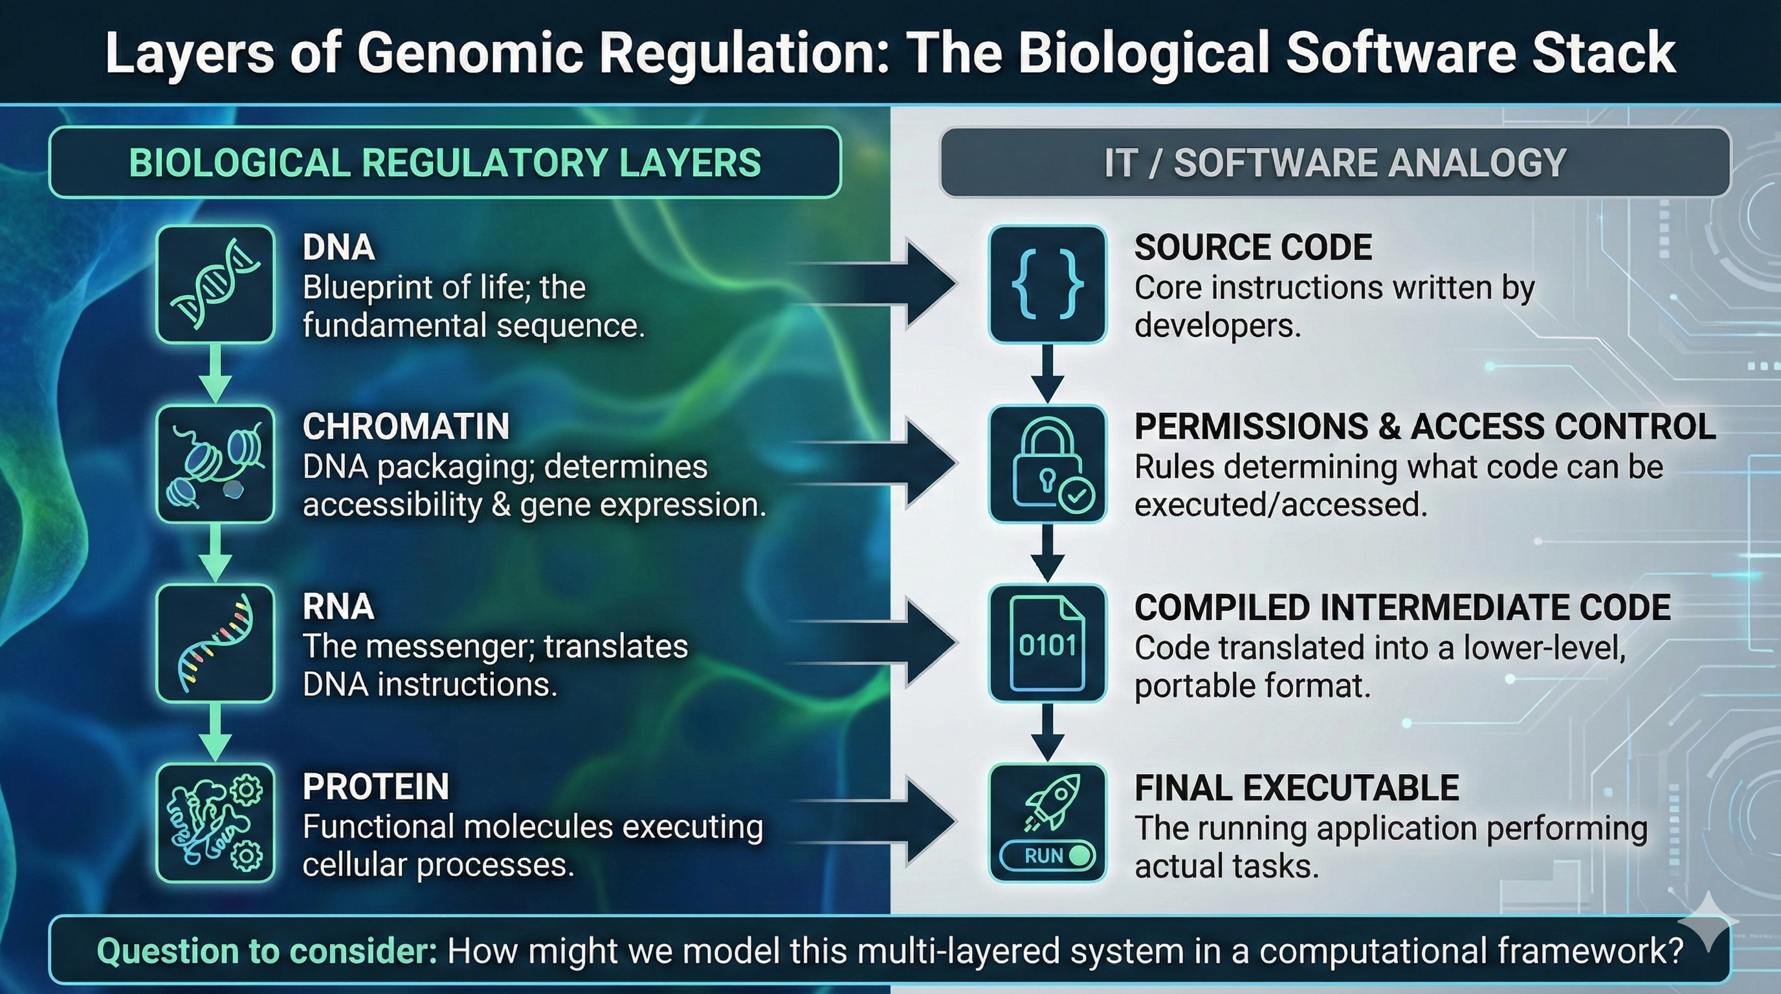
DNA → CHROMATIN → RNA → PROTEIN
Notes:
Let's begin by examining the layers of genomic regulation. At the core is the
DNA sequence, the blueprint of life. But DNA alone is not enough; it is packaged
in chromatin, whose modi cations determine accessibility and gene expression.
RNA serves as the messenger, translating DNA instructions into proteins, the
functional molecules executing cellular processes.
As IT students, you might think of this as a multi-layered software system:
DNA is the source code, chromatin modi cations are permissions and access
control, RNA is the compiled intermediate code, and proteins are the nal
executable. How might we model this in a computational framework? Keep
that question in mind as we progress.

Slide 4
BIG DATA CHALLENGES IN GENOMICS
💾 Huge sequencing datasets
📈 Complex network analyses
🤖 ML and AI applications
🧩 Multi-layer data integration
Notes:
From an IT perspective, genomics represents one of the most signi cant big data
challenges. Sequencing a single human genome generates hundreds of gigabytes
of raw data. Multiply this across thousands of individuals in a population study,
and you quickly face storage, processing, and analysis challenges.
We also need to think about the complexity of networks|gene regulatory
networks, protein interaction networks, and epigenetic layers all interact dy-
namically. Can you imagine designing algorithms that can e ciently integrate
this multi-layered data to predict cellular behavior? This is the essence of com-
putational genomics and a rich area for machine learning applications.

Slide 5
SEQUENCE → VARIANT → FUNCTION
🔹 Sequencing and read processing
🔹 Variant calling and annotation
🔹 Functional interpretation
🔹 IT analog – logs -> anomalities -> bugs
Notes:
To tackle this complexity, bioinformatics pipelines break down the problem into
sequential steps. First, sequencing reads are processed and mapped to a ref-
erence genome. Next, we identify variants, such as single nucleotide polymor-
phisms, insertions, deletions, and structural rearrangements. Finally, we inter-
pret the functional consequences of these variants using annotation, pathway
analysis, and network modeling.
Think of it like debugging a large software project: rst, you gather the
logs (sequencing data), then identify anomalies (variants), and nally, you trace
them to potential bugs a ecting performance (functional interpretation). Each
step has computational challenges and requires specialized tools.

Slide 6
DATABASES AND TOOLS IN GENOMICS
🗄️ UCSC Genome Browser, Ensembl
🛠️ Tools: BLAST, BWA, Bowtie
📦 Data formats: FASTA, GFF, BED
🔍 Importance for IT pipelines
Notes:
Finally, to perform these analyses, we rely on specialized databases and tools.
The UCSC Genome Browser and Ensembl provide comprehensive genome an-
notations, while tools such as BLAST, BWA, and Bowtie allow us to align and
query sequences e ciently. Standardized data formats like FASTA, GFF, and
BED enable interoperability across platforms and pipelines.
Before moving to sequencing technologies, ask yourself: what would happen
if you tried to analyze genome data without standardized formats and robust
databases? Could you imagine maintaining millions of sequences and anno-
tations without a well-structured system? This highlights the critical role of
computational infrastructure in modern genomics.

Slide 7


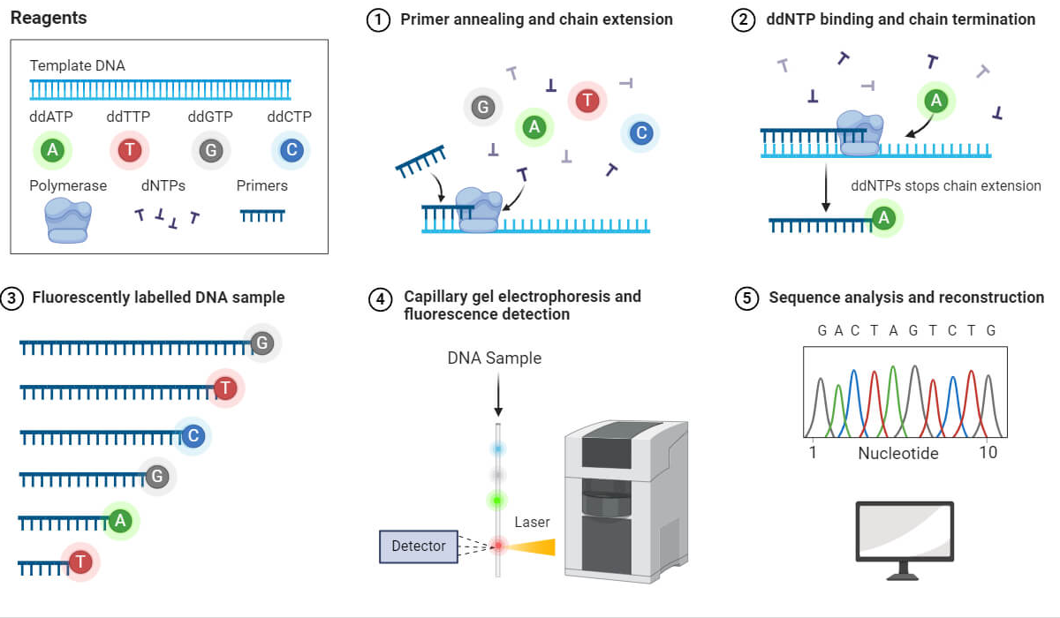
SANGER SEQUENCING
🧬 Sanger sequencing: gold standard
Notes:
Now that we've introduced the structure of genomic data and the role of bioin-
formatics in making sense of it, we can turn to the technologies that generate
this data in the rst place. Sequencing is essentially the process of reading the
letters of DNA|A, C, G, and T. The earliest method, Sanger sequencing, was
groundbreaking because it allowed researchers to determine the exact order of
nucleotides in a DNA fragment for the rst time.
Even though Sanger sequencing is slow and expensive by today's standards,
it set the foundation. Think of it like the early days of computing: the rst
machines were bulky and limited, but they de ned the framework that modern
systems evolved from. Sequencing technologies have followed a similar evolu-
tionary trajectory, becoming massively parallel, faster, and more cost-e ective.
As we explore these methods, ask yourself: how do we translate raw physical
signals|uorescence, electrical current disruptions, imaging data|into accu-
rate digital sequences?

Slide 8
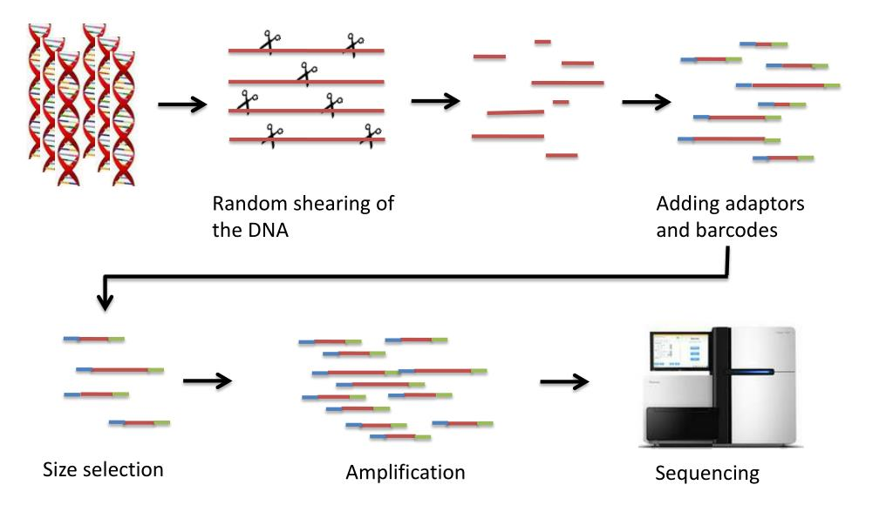
NGS SEQUENCING
Notes:
Next-generation sequencing, or NGS, revolutionized the eld by making se-
quencing massively parallel. Instead of reading a single DNA fragment at a
time, NGS platforms read millions of fragments simultaneously. Imagine de-
bugging not one thread, but millions of threads running concurrently|except
here the data is the genome, not a process.
The key idea is fragmentation. DNA is broken into small pieces, sequenced
individually, and later reassembled using computational algorithms. These tech-
nologies dramatically reduced sequencing cost and time, enabling entire genomes
to be sequenced in days rather than decades.
A question to consider: how does breaking DNA into millions of tiny frag-
ments|and later computationally stitching them back together|a ect the ac-
curacy and complexity of the nal assembly?

Slide 9
SHORT-READ SEQUENCING: ILLUMINA
🔹 High accuracy, low error rates
📏 Read length typically 100–300 bp
⚠️ GC-bias and coverage unevenness
💾 Commonly used for variant calling
Notes:
The most widely used form of NGS today is short-read sequencing, particularly
by Illumina. Here's how it works. First, DNA fragments are attached to a
surface where they undergo ampli cation, creating clusters of identical DNA
molecules. Then, uorescently labeled nucleotides are incorporated one at a
time, and the system takes high-resolution images to determine which base was
added.
It's a bit like QR code scanning on a massive scale: each cluster is a tiny code,
and the sequencer captures cycles of images to decode millions of these clusters
simultaneously. Short reads are highly accurate, but limited in length|typically
around 100{300 base pairs. This creates challenges for resolving repetitive re-
gions or large structural variants.
Consider how you might reconstruct a long text document if someone gave it
to you shredded into short strips. Which parts would be hard to piece together?
That's exactly the problem bioinformaticians face with short-read data.

Slide 10
LONG-READ SEQUENCING: PACBIO, ONT
📏 Read lengths up to 100 kb or more
⚠️ Higher raw error rates
🛠️ Useful for structural variant detection
🔗 Resolving repeats and complex regions
Notes:
To overcome those limitations, long-read sequencing technologies like Oxford
Nanopore and PacBio were developed. These can produce reads thousands or
even hundreds of thousands of bases long, allowing us to span repetitive regions
and reveal structural rearrangements that short reads struggle with.
Nanopore sequencing operates on a wonderfully elegant principle: a single
DNA molecule passes through a tiny pore, and each nucleotide disrupts an
electrical current in a characteristic way. It's like identifying objects by the
shadow they cast rather than by directly imaging them. PacBio, on the other
hand, uses real-time uorescence detection as a polymerase incorporates bases.
Long reads are transformative but come with trade-o s: they typically have
lower accuracy and generate noisier data. What strategies might you use as a
data scientist to correct noise in long, high-value signals?

Slide 11
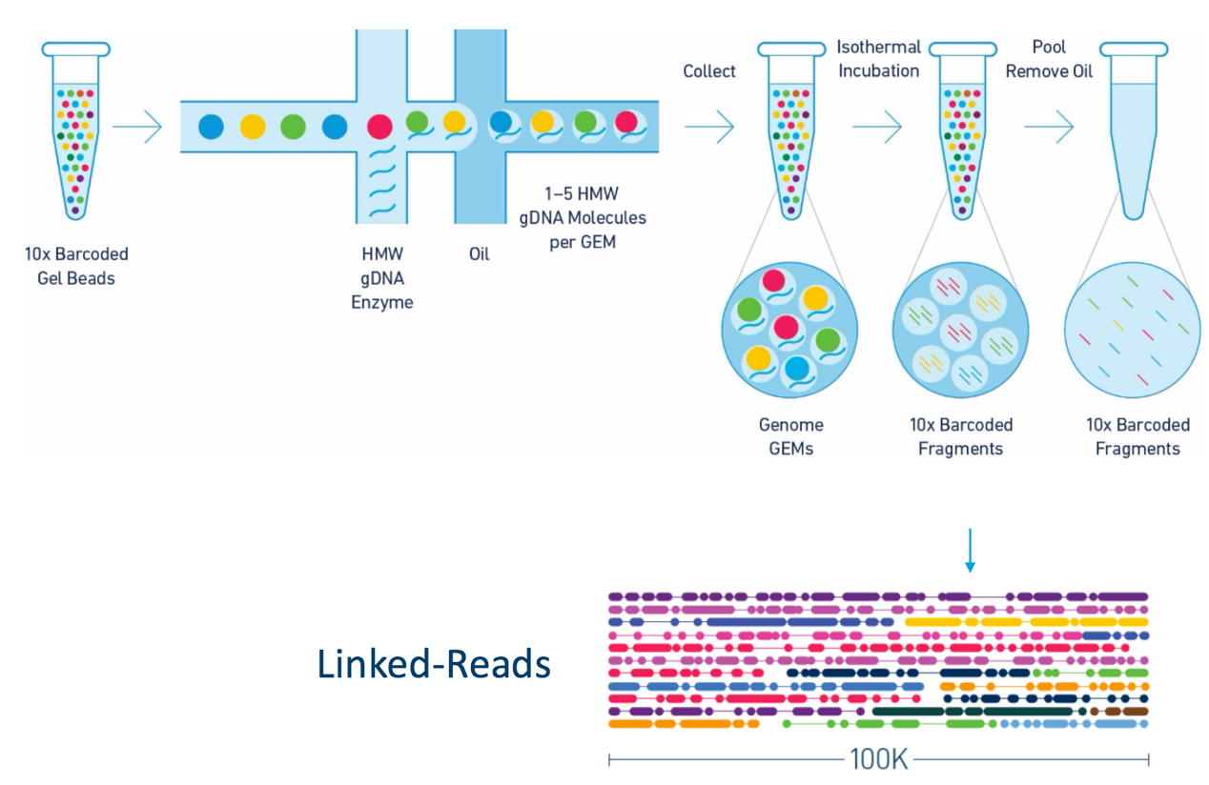
LINKED READS

Slide 12
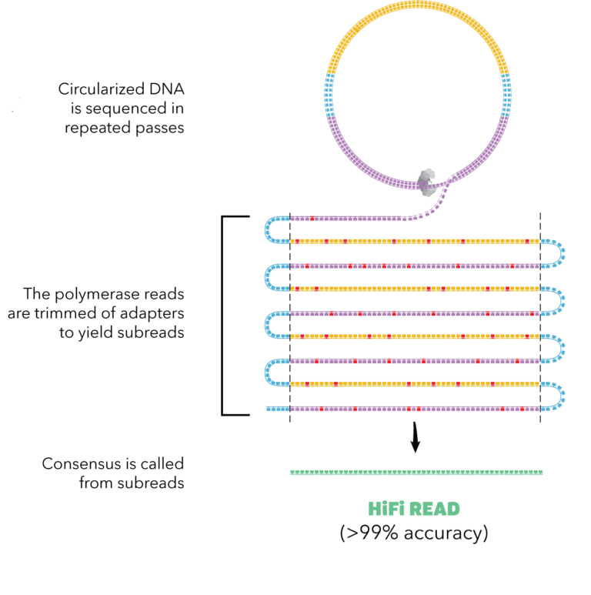
HIFI READS

Slide 13
LINKED READS AND HIFI READS
Feature | Linked Reads | HiFi Reads
Technology | 10X Genomics Chromium | PacBio SMRT (CCS)
Read length | Short reads (150 bp) grouped into virtual long reads | Single long reads (10–25 kb)
Accuracy | Same as short reads (very high) | Extremely high (≥99.9%)
Purpose | Long-range info, phasing, structural variants | Assembly, SVs, repeat resolution
Key idea | Barcoded partitions reconstruct context | Multi-pass consensus increases accuracy

Slide 14
FORMATS: FASTQ, BAM/CRAM, GFF/GTF, BED
📄 FASTQ: raw reads with quality scores
🗂️ BAM/CRAM: aligned reads
📝 GFF/GTF: gene annotations
📍 BED: genomic regions

Slide 15
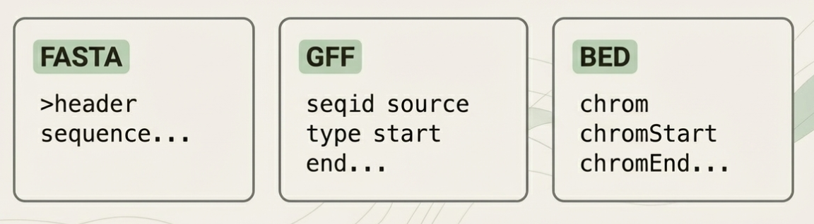
FORMATS: FASTQ, BAM/CRAM, GFF/GTF, BED

Slide 16
INDEXING GENOMIC FILES: BAI, CRAI, FAI
📌 Enable fast random access
💾 Required for large BAM/CRAM files
🔹 FAI for FASTA indexing
⚡ Critical for efficient pipelines

Slide 17
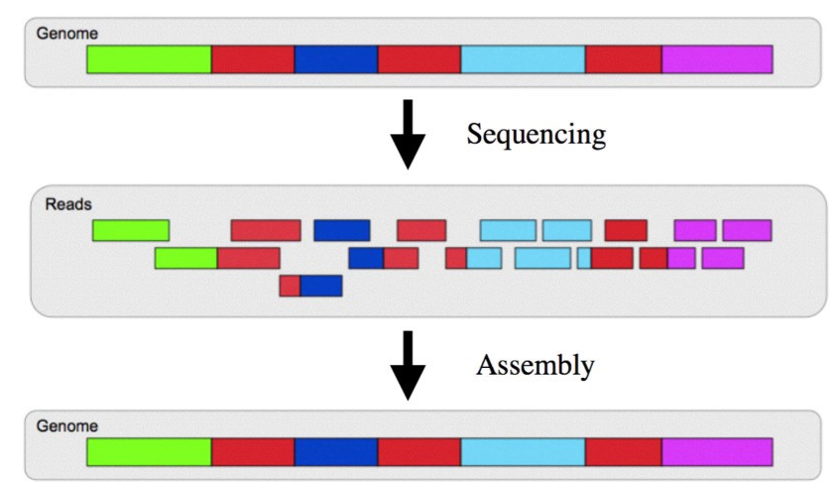
GENOME ASSEMBLY: OVERVIEW

Slide 18
OVERLAP–LAYOUT–CONSENSUS (OLC)
🔹 Step 1: Find overlaps between reads
🧩 Step 2: Layout reads into contigs
⚡ Step 3: Consensus sequence calling
💻 Used mainly for long reads

Slide 19
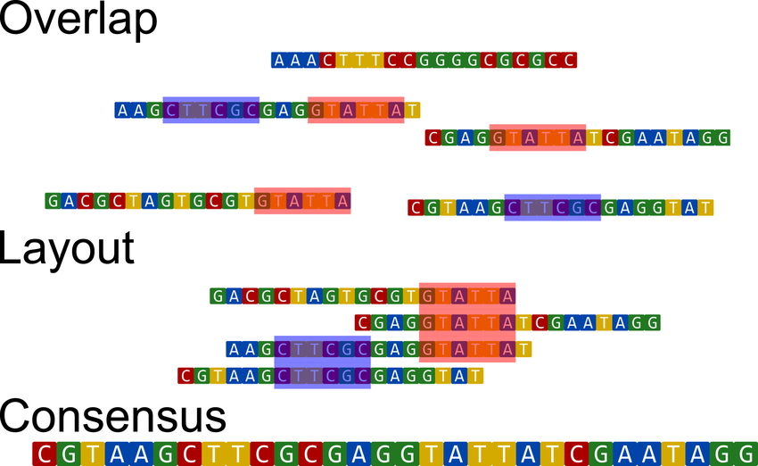
OVERLAP–LAYOUT–CONSENSUS (OLC)

Slide 20
DE BRUIJN GRAPHS FOR GENOME ASSEMBLY
🧬 Represent k-mers as nodes
🔗 Edges represent overlaps
⚠️ Handles repeats efficiently
💻 Used for short-read assembly
Notes:
De novo assembly, meaning assembly without a reference genome, relies heavily
on graph theory. Two main types of graphs dominate the eld: overlap graphs
and de Bruijn graphs. Overlap graphs connect reads that share signi cant
sequence overlap. De Bruijn graphs break reads into k-mers and connect them
based on shared pre xes and su xes.
You can imagine the de Bruijn graph as a giant puzzle where each piece
represents a short sequence, and edges represent the possibility that one piece
logically follows another. Instead of assembling puzzle pieces by shape, we
assemble by sequence similarity.
But the di culty lies not in nding connections|it lies in choosing the cor-
rect path through a highly complex graph full of branches, cycles, and repeated
motifs. This is why assembly is computationally demanding: many genomes
contain long, nearly identical sequences that create ambiguity in the graph.

Slide 21
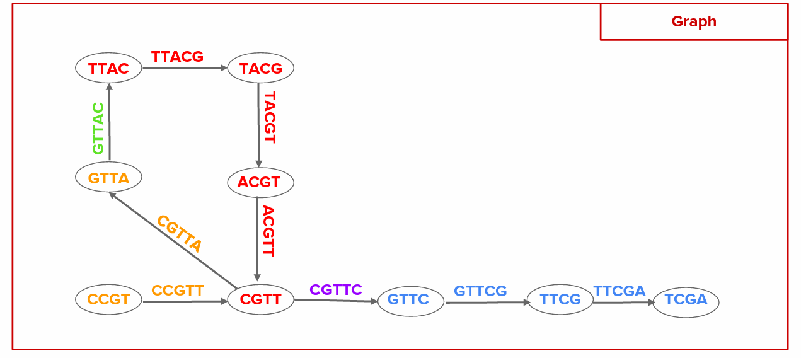
DE BRUIJN GRAPHS FOR GENOME ASSEMBLY
💻 Linear complexity O(E+V) [Hierholzer]

Slide 22
DE BRUIJN GRAPHS VS OLC
Feature / Concept | Overlap–Layout–Consensus (OLC) | De Bruijn Graph (DBG)
Basic idea | Build graph of whole-read overlaps | Break reads into k-mers,
Nodes represent | Entire reads | (k–1)-mers
Edges represent | Pairwise overlaps between reads | k-mers connecting two (k–1)-mers
Path found | Hamiltonian path (each node visited once) | Eulerian path (each edge visited once)

Slide 23
DE BRUIJN GRAPHS VS OLC - COMPLEXITY
Feature / Concept | Overlap–Layout–Consensus (OLC) | De Bruijn Graph (DBG)
Computational complexity | High – requires all-vs-all overlap: O(n²) comparisons; memory-heavy | Much lower – building k-mer graph is O(V + E), Eulerian path is O(V + E)
Memory usage | Heavy (long read storage + overlap matrix) | Compact after k-mer compression; very scalable

Slide 24
DE BRUIJN GRAPHS VS OLC - SCALABILITY
Feature / Concept | Overlap–Layout–Consensus (OLC) | De Bruijn Graph (DBG)
Best suited for | Long, low-error reads (PacBio, Oxford Nanopore) | Short reads (Illumina), massive datasets
Error handling | More tolerant; errors don’t explode node count | Sensitive: errors create many unique erroneous k-mers
Scalability to human genome | Hard but feasible with long-read tools (Flye, Miniasm) | Excellent scalability, used by short-read assemblers (SPAdes, Velvet)

Slide 25
REFERENCE-GUIDED ASSEMBLY
🔍 Align reads to an existing reference genome
🧩 Reconstruct the sequence by correcting and filling in differences
🧬 Detect variants by comparing aligned reads to the reference
🚀 Greatly reduces computational cost

Slide 26
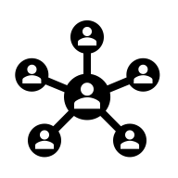
LINEAR REFERENCE GENOMES LIMITATIONS
⚠️ Miss structural variation
📊 Biases in read mapping
🧩 Does not capture population diversity
🔍 Affects variant interpretation

Slide 27
PANGENOME CONCEPTS
🗂️ Represent multiple genome sequences
🔗 Graph-based representation
💻 Capture SNPs, INDELs, SVs
⚡ Enables haplotype-aware analyses
Notes:
Traditionally, bioinformatics relied on a single reference genome, such as GRCh38
for humans. But one genome does not represent humanity. In fact, millions of
bases di er across populations, and many individuals contain sequences entirely
absent from the reference. A single linear genome cannot capture this diversity.
This is where pangenomics emerges. The idea is simple yet revolutionary:
instead of a single reference, build a shared representation of all genomic se-
quences found across individuals in a population. Instead of one book, imagine
having a library where each edition contributes unique chapters, alternative
storylines, and rearranged structures.
This solves a major conceptual problem: a linear reference imposes a false
sense of uniformity. A pangenome embraces natural diversity.

Slide 28
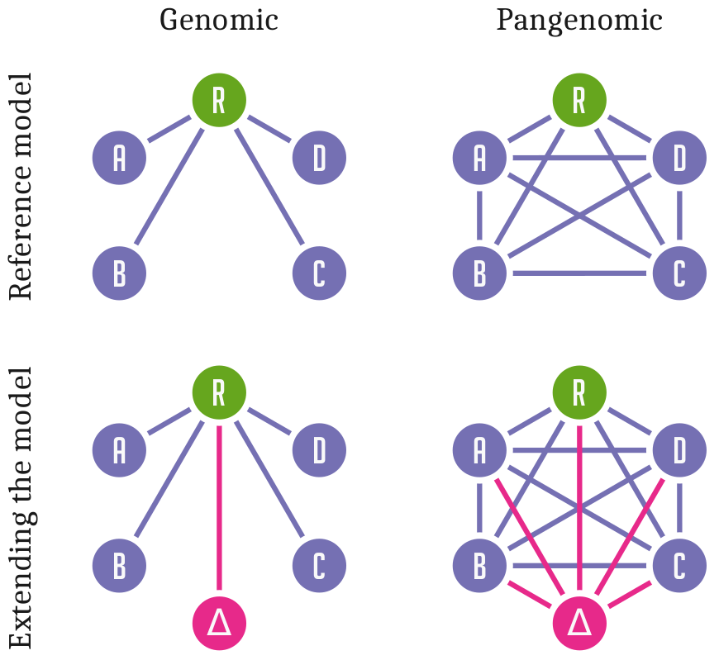
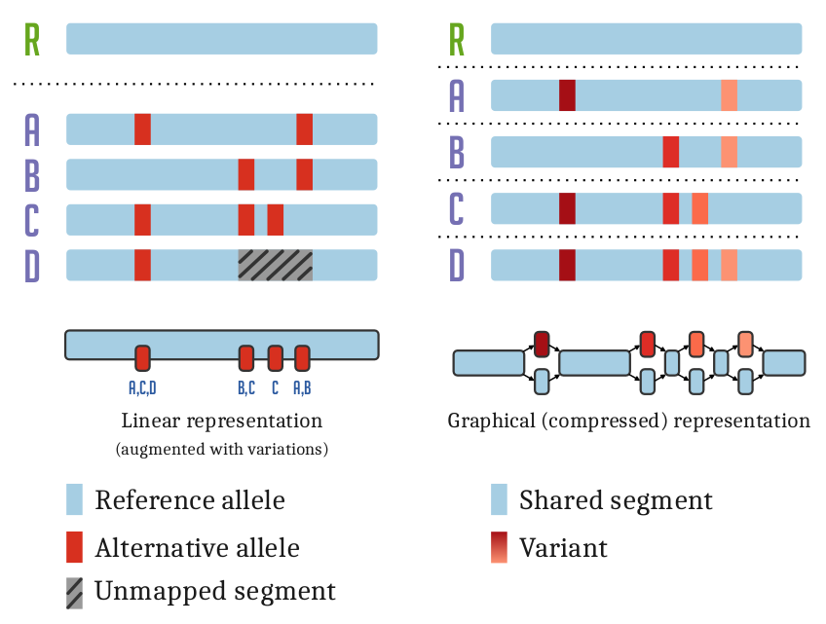
VARIATION GRAPHS
⚠️ Challenges: graph complexity, mapping ambiguity
Notes:
Pangenomes are often represented as graphs|speci cally, sequence graphs where
nodes represent genomic segments and edges represent permissible connections.
This allows alternative alleles, insertions, deletions, and rearrangements to co-
exist within the same coordinate system.
To return to the book analogy: imagine mapping all possible editions of a
novel into a single graph. Some editions may include extra paragraphs. Some re-
order chapters. Some contain alternative endings. A pangenome graph encodes
all these possibilities simultaneously, creating a shared but exible genomic
structure.
Graph genomes dramatically improve read alignment accuracy, especially in
regions where the linear reference is missing or incorrect. They also force us to
rethink algorithms traditionally built for one-dimensional sequences. Indexing
a genome graph is an active research frontier|one rich with opportunities for
creative computational thinking.

Slide 29
TOOLS FOR GRAPH GENOMES
🛠️ VG toolkit for graph construction and alignment
🚀 Giraffe for fast read mapping
🔹 Minigraph-cactus for population graphs
💻 Supports structural variation analyses

Slide 30
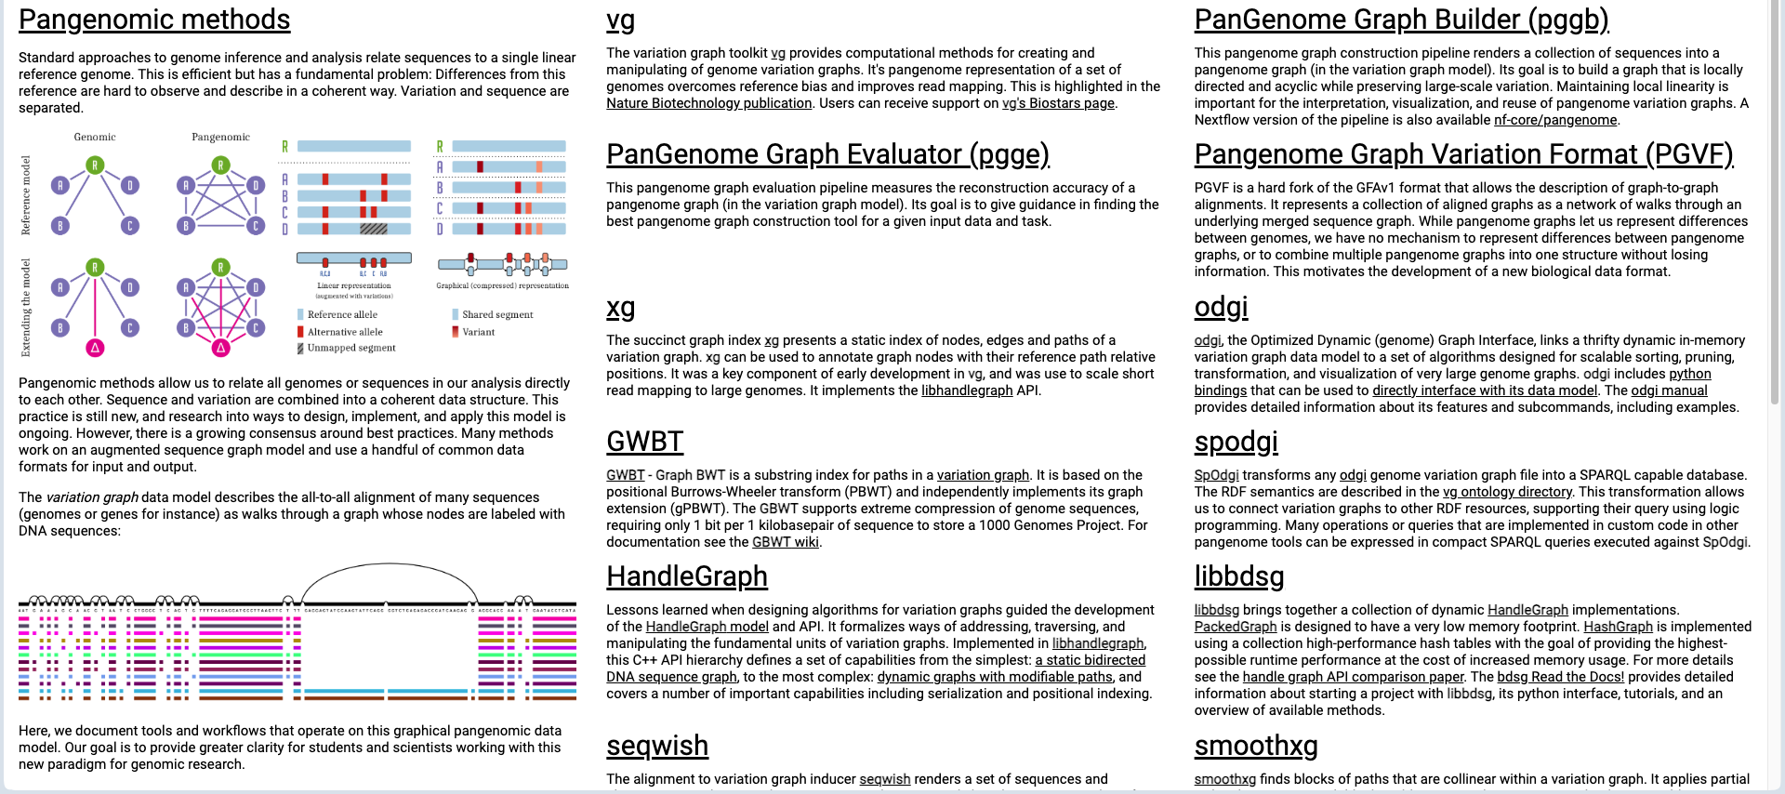
TOOLS FOR GRAPH GENOMES

Slide 31
APPLICATIONS OF PANGENOMICS
🧬 Identify population-specific variants
📊 Link SVs to phenotypes
🔍 Enhance reference genome utility

Slide 32
ALGORITHMIC CHALLENGES
⚠️ Mapping reads to graph is NP-hard
💻 Heuristic algorithms used
🗂️ Graph indexing strategies
📊 Accuracy vs speed trade-offs

Slide 33
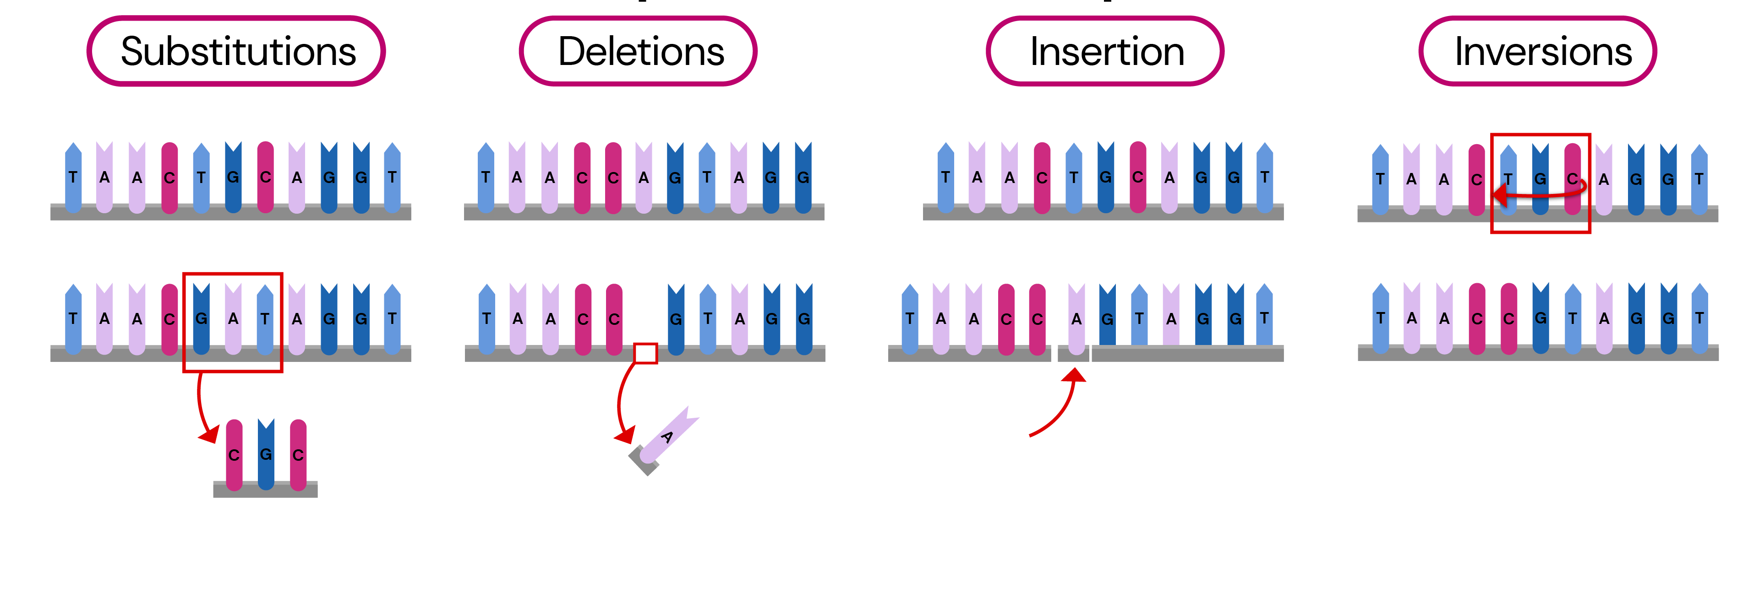

TYPES OF GENOMIC VARIATION
Notes:
As we move deeper into genomics, we shift our attention from assembling
genomes to understanding how they vary across individuals. Genomic variation
is the raw material of evolution and the underlying cause of many phenotypic
di erences|including disease susceptibility.
The smallest variations are single nucleotide polymorphisms, or SNPs, where
one letter of DNA is changed. Slightly larger changes include INDELs|insertions
or deletions of a few bases. Beyond these lie structural variants, which may in-
volve thousands or millions of bases being rearranged, duplicated, or inverted.
A useful analogy is version control in software: some changes involve tweak-
ing a single character; others involve deleting whole functions or moving les
across directories. Each type of variation can have di erent functional conse-
quences, and recognizing this complexity is key to interpreting biological data.

Slide 34
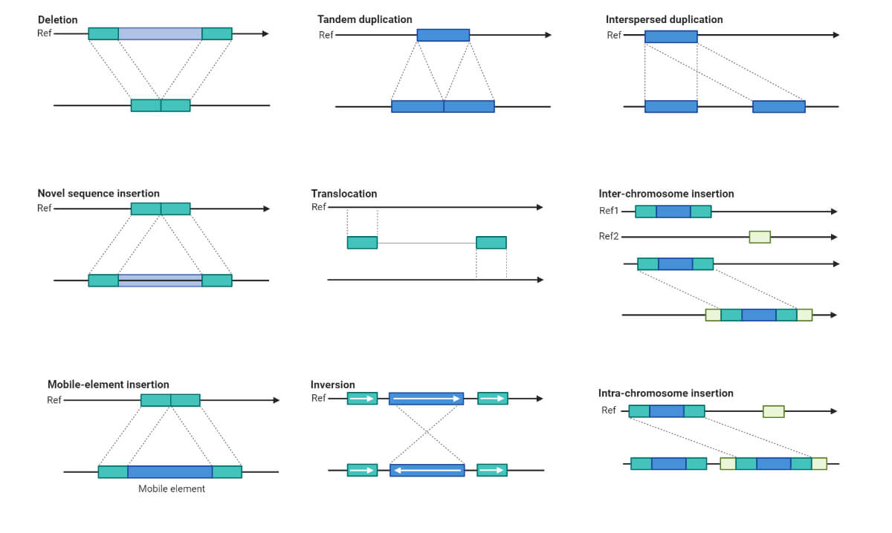
TYPES OF GENOMIC VARIATION

Slide 35
TYPES OF GENOMIC VARIATION
🧬 SNPs: single nucleotide polymorphisms
➕ INDELs: insertions and deletions
🔗 Structural variants: CNVs, inversions, translocations
⚡ Affect gene function and regulation

Slide 36
VARIANT CALLING
📊 Map reads to reference genome
🔍 Identify variants from alignments
⚠️ Filter low-quality calls
💻 Annotate for functional impact
Notes:
Once a genome has been sequenced, the next step is variant calling|identifying
which positions di er from the reference or the pangenome graph. This process
involves aligning sequencing reads, scanning the alignments for mismatches or
unexpected patterns, and distinguishing real variants from sequencing errors.
Imagine reading multiple noisy logs from a distributed system and attempt-
ing to distinguish real events from artifacts. Variant callers use probabilistic
models to decide whether a mismatch is truly present in the underlying genome
or just a glitch introduced by the sequencing machine.
The workow is typically: alignment preprocessing variant calling
ltering annotation. At each step, choices in parameters and algorithms im-
pact the nal interpretation. The question to keep in mind is: how do we balance
sensitivity|detecting true variants|with speci city|avoiding false positives?

Slide 37
SNP AND INDEL CALLERS
🛠️ GATK HaplotypeCaller for variant discovery
💻 FreeBayes: Bayesian SNP/INDEL calling
🔹 Platypus: integrates assembly-based calling
⚠️ Differences in sensitivity and specificity
Notes:
Different tools specialize in calling small variants. GATK's HaplotypeCaller is widely used due to its robustness and sophisticated local assembly around candidate variants. FreeBayes employs a haplotype-based Bayesian approach,
while Platypus integrates local assembly with powerful heuristics. You can think of these tools as di erent anomaly detection algorithms. Some rely on statistical modeling, others on graph reconstruction, and others on hybrid approaches. Each has strengths and weaknesses depending on coverage depth, read length, and the genomic context. As an IT-minded observer, you might ask: how should we evaluate these tools? What metrics - precision, recall, F1-score - best capture their performance when ground truth is hard to establish?

Slide 38
STRUCTURAL VARIANT DETECTION
🛠️ LUMPY: read-pair and split-read analysis
💻 Manta: sensitive SV detection
🔹 DELLY: paired-end and split-read integration
⚠️ Resolution limited by read length
Notes:
Structural variants are much more challenging to detect. Short reads may only capture the edges of large rearrangements, producing subtle signals such as discordant read pairs or unexpected depths of coverage. Tools like LUMPY,
Manta, and DELLY integrate multiple signals|paired-end mapping, split reads, and coverage anomalies|to infer the presence of large structural changes.
Consider how hard it would be to detect that two distant chapters in a book have swapped places by only reading small, randomly sampled fragments. Detecting structural variants is just as di cult. These tools essentially reconstruct
hidden rearrangements from indirect clues.
A thought-provoking question: given that long-read technologies can span structural variants more easily, what role will short-read SV callers play in the future? Will they become obsolete or evolve into hybrid tools?

Slide 39
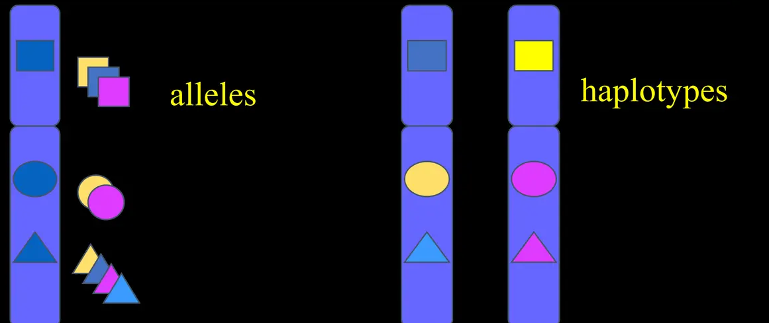
HAPLOTYPES
Notes:
Beyond identifying variants, we often want to know how they are arranged on each chromosome. Humans have two copies of each chromosome, and phasing determines which variants are inherited together. This matters because combinations of variants, not individual ones, often inuence traits or diseases.
Phasing is like reconstructing two different versions of a book that have been shredded and mixed together. The text pieces look similar, but subtle differences reveal their origin. Computational phasing algorithms use statistical linkage patterns, sequencing reads, or long-range information to separate variants into haplotypes.
Here's a question: if certain variants only have an effect when inherited together, how might incorrect phasing inuence downstream biological conclusions?

Slide 40
PHASING AND HAPLOTYPE RECONSTRUCTION
🔗 Assign variants to parental haplotypes
💻 Use read overlaps and linkage
⚠️ Important for compound heterozygosity
🧩 Tools: WhatsHap, HapCUT2
Notes:
Beyond identifying variants, we often want to know how they are arranged on each chromosome. Humans have two copies of each chromosome, and phasing determines which variants are inherited together. This matters because combinations of variants, not individual ones, often inuence traits or diseases.
Phasing is like reconstructing two different versions of a book that have been shredded and mixed together. The text pieces look similar, but subtle differences reveal their origin. Computational phasing algorithms use statistical linkage patterns, sequencing reads, or long-range information to separate variants into haplotypes.
Here's a question: if certain variants only have an effect when inherited together, how might incorrect phasing inuence downstream biological conclusions?

Slide 41
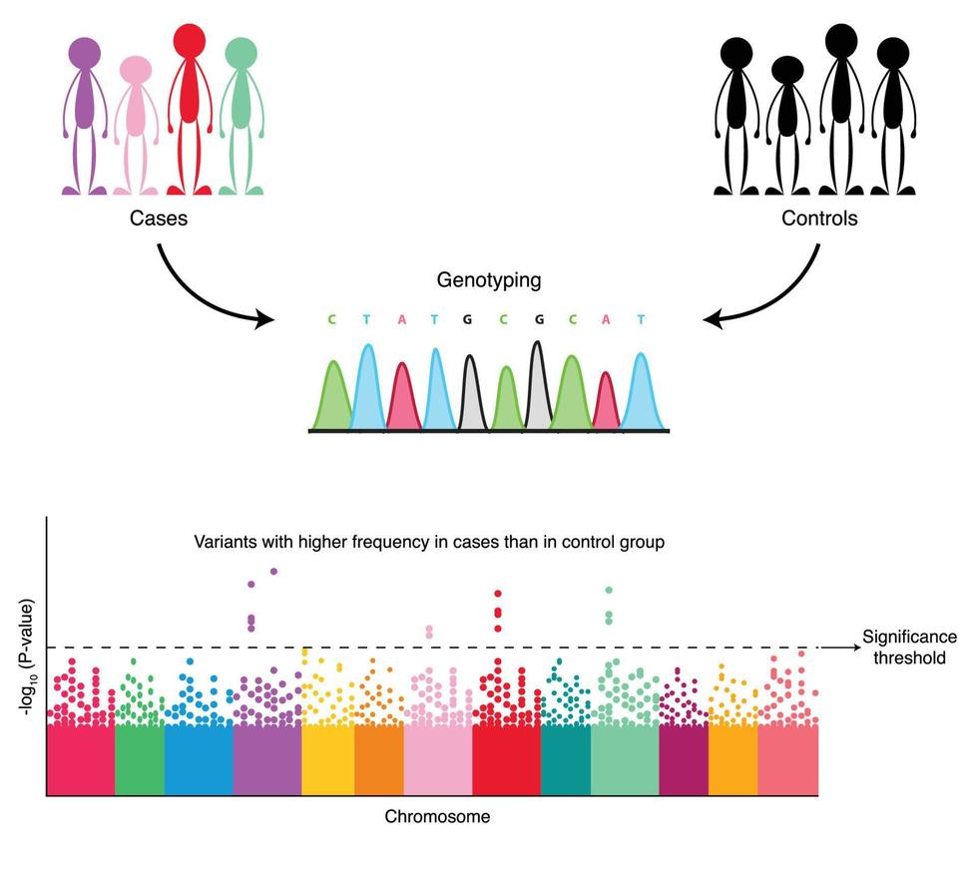
GWAS OVERVIEW
Notes:
Genome-wide association studies (GWAS) attempt to link variations in the genome with observable traits. By comparing genetic variants across thousands of individuals, we look for statistical associations between speci c alleles and
phenotypes such as disease risk, height, or metabolic traits.
Think of GWAS as large-scale correlation mining. We scan millions of genomic positions and ask: does the frequency of a particular allele di er between individuals with and without the phenotype? If so, that region may harbor a
genetic factor inuencing the trait.
However, correlation is not causation. Many variants identi ed by GWAS are merely markers linked to causal changes. This raises a critical question: how do we interpret associations without assuming direct effect?

Slide 42
GWAS OVERVIEW
📊 Identify loci linked to traits
🧬 SNP-trait association
⚠️ Confounding factors
💻 Population-scale studies
Notes:
Genome-wide association studies (GWAS) attempt to link variations in the genome with observable traits. By comparing genetic variants across thousands of individuals, we look for statistical associations between speci c alleles and
phenotypes such as disease risk, height, or metabolic traits.
Think of GWAS as large-scale correlation mining. We scan millions of genomic positions and ask: does the frequency of a particular allele di er between individuals with and without the phenotype? If so, that region may harbor a
genetic factor inuencing the trait.
However, correlation is not causation. Many variants identi ed by GWAS are merely markers linked to causal changes. This raises a critical question: how do we interpret associations without assuming direct effect?

Slide 43
GWAS STATISTICAL MODELS
📈 Logistic regression for binary traits
🧮 Linear mixed models for continuous traits
⚠️ Control for population structure
💻 Reduce false positives
Notes:
The statistical foundation of GWAS typically involves logistic regression for binary traits (e.g., disease presence) or linear regression for continuous traits (e.g., height). But these naive models ignore one major issue: individuals are
not independent. They share ancestry, which introduces correlations across the genome.
Linear mixed models (LMMs) address this by incorporating random effects that account for genetic relatedness. In computational terms, this is similar to modeling autocorrelation in time series or clustering in high-dimensional data.
Mixed models signiffcantly reduce false positives caused by population structure.
Consider: how would you scale a regression analysis across millions of variants and hundreds of thousands of individuals? This challenge has led to some of the most optimized algorithms in computational biology.

Slide 44
POPULATION STRUCTURE CORRECTION
Notes:
Population structure can confound GWAS results: allele frequencies often differ across subpopulations for reasons unrelated to the phenotype. Principal component analysis (PCA) is therefore used to infer ancestry axes and include them as covariates.
Kinship matrices quantify the genetic similarity between individuals| effectively a distance metric in genomic space. Together, PCA and kinship correction ensure that associations reect biological relevance rather than demographic
history.
Imagine trying to analyze user behavior without accounting for regional diffrences - you would likely infer incorrect conclusions. Similarly, correcting for population structure is essential to avoid misleading associations in genomic
studies.

Slide 45
POPULATION STRUCTURE CORRECTION
🧩 PCA to detect ancestry differences
📊 Kinship matrices for relatedness
⚠️ Avoid spurious associations
💻 Implemented in PLINK, GEMMA
Notes:
Population structure can confound GWAS results: allele frequencies often differ across subpopulations for reasons unrelated to the phenotype. Principal component analysis (PCA) is therefore used to infer ancestry axes and include them as covariates.
Kinship matrices quantify the genetic similarity between individuals| effectively a distance metric in genomic space. Together, PCA and kinship correction ensure that associations reect biological relevance rather than demographic
history.
Imagine trying to analyze user behavior without accounting for regional diffrences - you would likely infer incorrect conclusions. Similarly, correcting for population structure is essential to avoid misleading associations in genomic
studies.

Slide 46
TOOLS FOR GWAS
🛠️ PLINK: QC, association tests
💻 BOLT-LMM: fast linear mixed models
🔹 GEMMA: Bayesian and frequentist models
⚡ Scales to hundreds of thousands of samples
Notes:
PLINK remains the foundational tool for GWAS preprocessing, ltering, and basic association testing. For large datasets, tools like BOLT-LMM and GEMMA implement effcient mixed-model algorithms to handle millions of variants and
hundreds of thousands of samples.
Think of PLINK as the classic Swiss army knife - reliable, exible, foundational-while BOLT-LMM and GEMMA are specialized high-performance engines optimized for scaling. The computational ingenuity behind these tools
is impressive: they reduce what would otherwise be weeks of computation to hours.
When working with these tools, consider: how do data structures, sparse matrices, and algorithmic optimizations shape biological discovery?

Slide 47
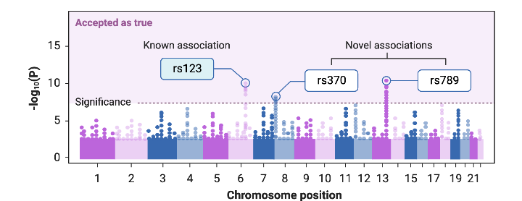
VISUALIZATION OF GWAS RESULTS
📊 Manhattan plot for genome-wide p-values
📈 QQ plot to check for inflation
Notes:
Finally, once associations have been computed, we need intuitive visualizations. Manhattan plots display the signiffcance of each variant across the genome, with peaks indicating regions of potential interest. They resemble a city sky-
line|hence the name. QQ plots compare observed p-values to expected ones to detect ination caused by confounding or technical issues.
Visualization plays a critical role in interpretation. Peaks must be inspected carefully: are they true biological signals or artifacts of sample structure? Do they align with known genes or regulatory regions?
Here's a final question for this section: how much can visualization reveal that raw statistics alone cannot? And how should we train ourselves to detect subtle patterns in these large genomics datasets?

Slide 48
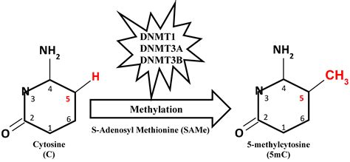

DNA METHYLATION
Notes:
We now turn to one of the most inuential layers of genomic regulation: DNA methylation. The most common form is 5-methylcytosine (5mC), where a methyl group is added to cytosine, primarily at CpG dinucleotides. Clusters
of these CpG sites|known as CpG islands - tend to occur near promoters and regulatory regions.
You can think of methylation as a \permission layer" on top of DNA. While the underlying code remains unchanged, methylation marks determine which regions are accessible for transcription. It's similar to file permissions in a Unix
system: even if the file exists, access can be denied.
As we explore these mechanisms, consider: how might adding a single chemical group profoundly change the behavior of an entire gene network?

Slide 49
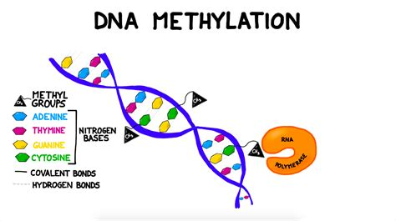
DNA METHYLATION
Notes:
We now turn to one of the most inuential layers of genomic regulation: DNA methylation. The most common form is 5-methylcytosine (5mC), where a methyl group is added to cytosine, primarily at CpG dinucleotides. Clusters
of these CpG sites|known as CpG islands - tend to occur near promoters and regulatory regions.
You can think of methylation as a \permission layer" on top of DNA. While the underlying code remains unchanged, methylation marks determine which regions are accessible for transcription. It's similar to file permissions in a Unix
system: even if the file exists, access can be denied.
As we explore these mechanisms, consider: how might adding a single chemical group profoundly change the behavior of an entire gene network?

Slide 50
DNA METHYLATION
🧬 5-methylcytosine occurs mainly at CpG sites
🔒 Silences gene promoters
💻 Maintains genomic stability
⚡ Epigenetic regulation without sequence change
Notes:
We now turn to one of the most inuential layers of genomic regulation: DNA methylation. The most common form is 5-methylcytosine (5mC), where a methyl group is added to cytosine, primarily at CpG dinucleotides. Clusters
of these CpG sites|known as CpG islands - tend to occur near promoters and regulatory regions.
You can think of methylation as a \permission layer" on top of DNA. While the underlying code remains unchanged, methylation marks determine which regions are accessible for transcription. It's similar to file permissions in a Unix
system: even if the file exists, access can be denied.
As we explore these mechanisms, consider: how might adding a single chemical group profoundly change the behavior of an entire gene network?

Slide 51
BIOLOGICAL ROLES
🔹 Regulates transcriptional activity
🧬 Enhancers modulated by methylation
⚠️ Imprinting controls parent-of-origin expression
💻 Relevance for disease studies
Notes:
Methylation plays many regulatory roles. At promoters, high methylation usually silences transcription. Enhancers|regulatory elements distant from genes - also depend on methylation states to modulate activity. Genomic imprinting relies on parent-specific methylation patterns to ensure that only one allele of certain genes is expressed.
Imagine if every configuration file in a software system contained parameters that depend on whether it came from \parent A" or \parent B." Cells must maintain extremely precise methylation patterns to preserve these imprinted
instructions across divisions.
Here's a question: how stable should these regulatory marks be? Too rigid, and the cell can't adapt; too loose, and essential developmental programs break down.

Slide 52
DNA METHYLATION & AGING
⏳ Methylation patterns correlate with biological age
📊 CpG site selection is critical
💻 Models predict metabolic age
⚡ Useful for age-related disease research
Notes:
One of the most fascinating discoveries in recent years is that methylation patterns change predictably with age. These changes occur across the genome in a reproducible way, reflecting environmental exposures, metabolic state, and
biological wear.
Epigenetic clocks use methylation levels at specific CpG sites to estimate biological age|sometimes more accurately than chronological age. In a sense, methylation patterns are like timestamps in a le system, quietly recording the
history of every cell.
This raises profound questions: if aging leaves an epigenetic footprint, can we read it? And more importantly, can we reverse it?

Slide 53
HORVATH CLOCK
🧬 353 CpG sites selected
📊 Multivariate linear regression
⚡ Predicts tissue-independent biological age
💻 Widely used in epigenetics research
Notes:
Steve Horvath's epigenetic clock was the first to gain widespread attention. Using elastic net regression, Horvath identified a set of CpG sites whose methylation levels predict age across many tissue types.
The idea is elegant: instead of trying to model the entire epigenome, the clock focuses on a curated subset of sites that change in a coordinated way. It’s like selecting a few well-chosen metrics - CPU temperature, memory usage, I/O
Patterns - to estimate the health of a complex system.
The Horvath clock demonstrates that aging is encoded not in random decay but in measurable, interpretable molecular changes.

Slide 54
GRIMAGE AND PHENOAGE MODELS
⚡ Improved prediction of mortality
📊 Incorporates DNA methylation & phenotypic traits
🧬 Adds predictive power over chronological age
💻 Computational modeling with regression
Notes:
Newer epigenetic clocks, such as GrimAge and PhenoAge, extend the concept.
Instead of predicting chronological age alone, they predict physiological decline,
morbidity risk, and even lifespan. They incorporate methylation proxies for
plasma proteins, smoking exposure, and inammatory factors.
These models are a reminder that the epigenome integrates signals from
across the body. A cell's methylation pattern reects not only its internal state
but also years of systemic inuences|stress, diet, environment.
This prompts a deeper question: if the epigenome is such a sensitive recorder
of life experience, could it also serve as a guide for individualized medicine?

Slide 55
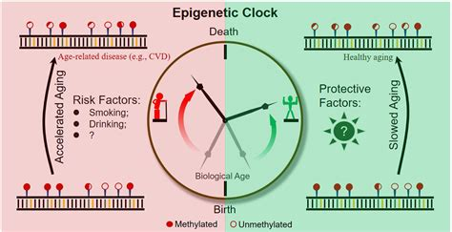
GRIMAGE AND PHENOAGE MODELS

Slide 56
DEMETHYLATION IN GERM CELLS
🔹 TET1/2/3 oxidize 5mC
💻 Base excision repair restores C
⚠️ Erases epigenetic marks for totipotency
🧬 Some imprinted loci remain methylated
Notes:
Although methylation patterns are stable, they are not permanent. In germ
cells, nearly all methylation marks are erased and re-established. This ensures
that the next generation begins with a clean epigenetic slate, rather than inher-
iting accumulated regulatory noise.
Two key mechanisms accomplish this: active demethylation via TET en-
zymes, which oxidize 5mC to 5hmC and further derivatives; and DNA repair
pathways that remove the modi ed bases altogether.
Imagine a system reset that not only clears con guration les but also
rewrites them following a carefully orchestrated developmental program. This
epigenetic reprogramming is essential for embryogenesis|and remains one of
the most remarkable biological processes.

Slide 57
BISULFITE SEQUENCING
💧 Treat DNA with bisulfite to convert C→U
📝 Sequence to detect methylated vs unmethylated C
⚠️ Incomplete conversion causes bias
💻 Analysis with Bismark, methylKit
Notes:
To measure methylation experimentally, one of the gold-standard techniques is
bisul te sequencing. Treatment with bisul te converts unmethylated cytosines
into uracils, while methylated cytosines remain unchanged. After sequencing,
these di erences reveal the methylation state at single-base resolution.
It's a clever chemical hack: by forcing a predictable mutation in unmethy-
lated cytosines, we indirectly read methylation. However, bisul te treatment
damages DNA signi cantly and can introduce its own biases.
As you think about this method, ask yourself: how would you design a
data processing pipeline to distinguish chemical conversion artifacts from true
biological methylation signals?

Slide 58
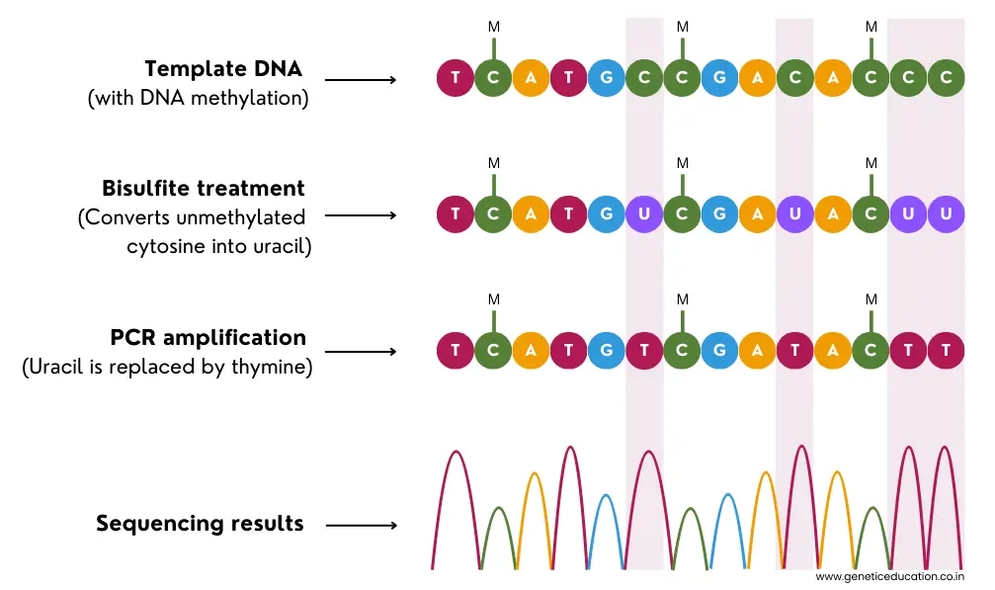
BISULFITE SEQUENCING
Notes:
To measure methylation experimentally, one of the gold-standard techniques is
bisul te sequencing. Treatment with bisul te converts unmethylated cytosines
into uracils, while methylated cytosines remain unchanged. After sequencing,
these di erences reveal the methylation state at single-base resolution.
It's a clever chemical hack: by forcing a predictable mutation in unmethy-
lated cytosines, we indirectly read methylation. However, bisul te treatment
damages DNA signi cantly and can introduce its own biases.
As you think about this method, ask yourself: how would you design a
data processing pipeline to distinguish chemical conversion artifacts from true
biological methylation signals?

Slide 59
OXIDATIVE BISULFITE SEQUENCING
🔹 Differentiates 5mC and 5hmC
💻 Important for understanding dynamic methylation
⚠️ Adds experimental complexity
📊 Quantitative analysis of oxidation levels
Notes:
Bisul te sequencing cannot distinguish 5mC from 5-hydroxymethylcytosine (5hmC),
an important intermediate in demethylation. Oxidative bisul te sequencing in-
troduces an oxidation step that converts 5hmC into a form detectable separately
from 5mC.
This is similar to having two types of encrypted messages that look identical
until you apply a special decryption key. Only then do the di erences emerge.
Understanding 5hmC distributions helps us track active demethylation, es-
pecially in neuronal tissues and early development.

Slide 60
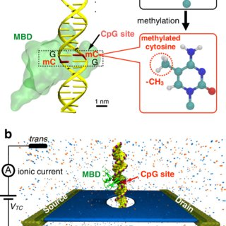
NANOPORE METHYLATION CALLING
Notes:
Nanopore sequencing o ers a fundamentally di erent way to detect methylation.
Instead of chemical conversion, it observes changes in electrical current as DNA
passes through a nanopore. Methylated bases produce subtly di erent current
disruptions.
Machine learning models|often deep neural networks|translate these elec-
trical signatures into methylation calls. It's a pattern recognition challenge:
interpreting noisy sensor data in real time to classify base modi cations.
A key question: how do we ensure these models generalize across di erent
sequencing runs, chemistries, and sample types?

Slide 61
NANOPORE METHYLATION CALLING
⚡ Direct detection from sequencing signal
🧩 Detects 5mC and other modifications
💻 Tools: Nanopolish, Megalodon
🔍 Real-time methylation analysis
Notes:
Nanopore sequencing o ers a fundamentally di erent way to detect methylation.
Instead of chemical conversion, it observes changes in electrical current as DNA
passes through a nanopore. Methylated bases produce subtly di erent current
disruptions.
Machine learning models|often deep neural networks|translate these elec-
trical signatures into methylation calls. It's a pattern recognition challenge:
interpreting noisy sensor data in real time to classify base modi cations.
A key question: how do we ensure these models generalize across di erent
sequencing runs, chemistries, and sample types?

Slide 62
TOOLS FOR METHYLATION ANALYSIS
🛠️ Bismark: bisulfite alignment
📊 MethylKit: statistical analysis
💻 Nanopolish: nanopore methylation calling
⚡ Integration into pipelines
Notes:
Once methylation data is generated, analysis tools become crucial. Bismark
aligns bisul te-treated reads and performs methylation calling. MethylKit sup-
ports di erential methylation analysis across conditions. Nanopolish interprets
methylation directly from nanopore signals.
Each tool solves a di erent part of the pipeline|alignment, quanti cation,
statistical testing. As with variant calling, choosing the right tool depends on
the experimental design, sequencing method, and biological question.
When evaluating tools, think about reproducibility, scalability, and how
much noise the method can tolerate before accuracy drops.

Slide 63
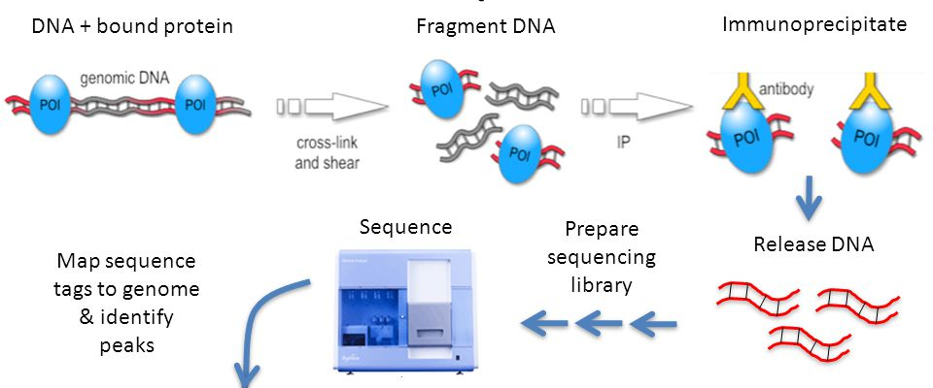
EPIGENOMIC PROFILING
Notes:
Beyond methylation, we also want to understand protein{DNA interactions.
ChIP-seq (chromatin immunoprecipitation sequencing) captures regions of the
genome bound by speci c proteins, such as transcription factors or histone mod-
i cations.
The method immunoprecipitates DNA{protein complexes and sequences the
associated DNA fragments. This identi es areas where regulatory proteins in-
teract with the genome.
You can think of it like using a magnet to pull out all instances of a par-
ticular \keyword" embedded throughout a large document. The resulting data
highlight the regulatory hotspots.

Slide 64
EPIGENOMIC PROFILING
🧬 Map protein-DNA interactions
📊 Detect histone modifications or TF binding
💻 Requires peak calling algorithms
⚠️ Noise and artifacts possible
Notes:
Beyond methylation, we also want to understand protein{DNA interactions.
ChIP-seq (chromatin immunoprecipitation sequencing) captures regions of the
genome bound by speci c proteins, such as transcription factors or histone mod-
i cations.
The method immunoprecipitates DNA{protein complexes and sequences the
associated DNA fragments. This identi es areas where regulatory proteins in-
teract with the genome.
You can think of it like using a magnet to pull out all instances of a par-
ticular \keyword" embedded throughout a large document. The resulting data
highlight the regulatory hotspots.

Slide 65
PEAK CALLING ALGORITHMS
🛠️ MACS2: model-based analysis of ChIP-seq
💻 Genrich: ATAC/ChIP-seq peak detection
⚠️ Threshold selection impacts results
📊 Outputs: peaks, scores, p-values
Notes:
ChIP-seq produces a pileup of aligned reads, and peak-calling algorithms iden-
tify enriched regions|\peaks"|representing protein binding sites. MACS2 is
the most widely used algorithm, modeling background noise and detecting sta-
tistically enriched regions. Genrich is optimized for ATAC-seq and DNase-seq
but also works for ChIP.
Peak calling is fundamentally a signal processing task: identifying meaning-
ful signals above noise in a one-dimensional coverage track.
A thought to consider: how do we balance sensitivity with false discovery,
especially in highly repetitive or noisy genomic regions?

Slide 66
CHROMATIN

Slide 67
ATAC-SEQ AND DNASE-SEQ
💻 Map accessible DNA regions
🔹 ATAC-seq uses Tn5 transposase
⚠️ Biases in fragment size distribution
📝 Peaks correspond to regulatory regions
Notes:
ATAC-seq and DNase-seq identify open chromatin regions|the accessible parts
of the genome where transcription factors can bind. Instead of targeting speci c
proteins, these methods probe the physical accessibility of DNA.
ATAC-seq uses a Tn5 transposase to insert sequencing adapters preferen-
tially into accessible regions. DNase-seq uses DNase I enzyme to cut DNA at
open sites. These approaches reveal the regulatory landscape of the genome.
Think of open chromatin as unlocked doors in a building. Mapping these
doors helps us understand which regulatory pathways are active in each cell
type.

Slide 68
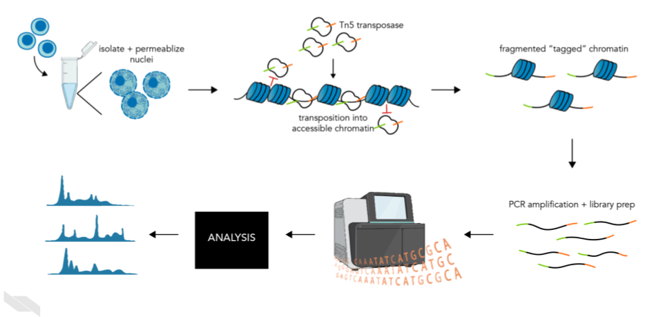
ATAC-SEQ AND DNASE-SEQ
Notes:
ATAC-seq and DNase-seq identify open chromatin regions|the accessible parts
of the genome where transcription factors can bind. Instead of targeting speci c
proteins, these methods probe the physical accessibility of DNA.
ATAC-seq uses a Tn5 transposase to insert sequencing adapters preferen-
tially into accessible regions. DNase-seq uses DNase I enzyme to cut DNA at
open sites. These approaches reveal the regulatory landscape of the genome.
Think of open chromatin as unlocked doors in a building. Mapping these
doors helps us understand which regulatory pathways are active in each cell
type.

Slide 69
CHROMATIN STATE MODELING
🧩 Hidden Markov Models segment genome
📊 Identify chromatin states (active, repressed)
💻 Integrates multiple histone marks
⚡ Useful for regulatory annotation
Notes:
Finally, to integrate epigenomic data|methylation, ChIP-seq, ATAC-seq|we
use chromatin state models such as ChromHMM and Segway. These tools apply
hidden Markov models or dynamic Bayesian networks to assign genomic regions
to functional states: promoters, enhancers, repressed regions, and more.
It's similar to clustering high-dimensional data into meaningful categories.
The challenge is that the underlying biology is complex, and the models must
infer structure from noisy, heterogeneous datasets.
A closing question for this section: as we move toward multi-omics integra-
tion, how can we design computational frameworks that merge these disparate
signals into a uni ed understanding of gene regulation?

Slide 70
TELOMERE BIOLOGY
🧬 TTAGGG repeats at chromosome ends
🛡️ Shelterin protects telomeres
⚠️ End-replication problem causes shortening
💻 Important for aging and cancer studies
Notes:
Let us now turn to a remarkable piece of biological engineering: telomeres.
These are repetitive DNA sequences|TTAGGG in humans|located at the
ends of chromosomes. You can imagine them as the plastic caps at the end
of shoelaces. Without those caps, the ends fray, and the shoelaces become
unusable. Similarly, without telomeres, chromosome ends would be mistaken
for DNA breaks, triggering inappropriate repair responses.
But telomeres are not just passive protective caps. They are safeguarded by
a specialized protein complex known as Shelterin. This complex folds telomeres
into loop structures, hiding them from the cell's DNA repair machinery. It
is as if the chromosome ends wear a protective glove that signals, \I am not
broken|please do not x me."
The reason telomeres exist at all stems from a fundamental limitation of
DNA replication: the end-replication problem. DNA polymerase cannot fully
replicate the very ends of linear chromosomes, causing telomeres to shorten with
each cell division. This raises a fascinating question: if every cell has this built-
in countdown, how do long-lived species|or stem cells|manage to preserve
genomic stability over decades?

Slide 71
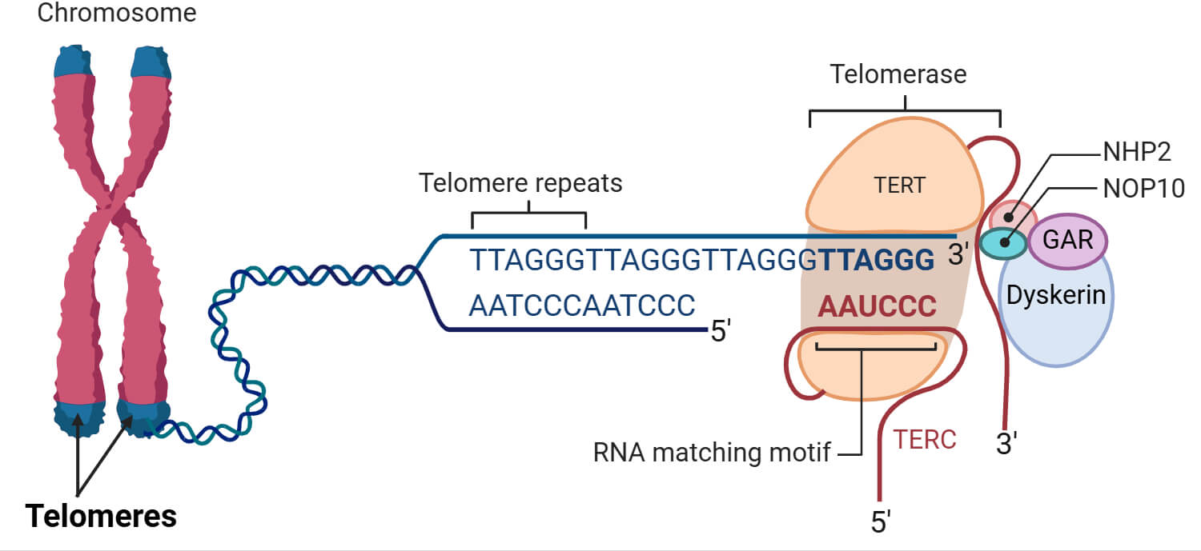
TELOMERE BIOLOGY
Notes:
Let us now turn to a remarkable piece of biological engineering: telomeres.
These are repetitive DNA sequences|TTAGGG in humans|located at the
ends of chromosomes. You can imagine them as the plastic caps at the end
of shoelaces. Without those caps, the ends fray, and the shoelaces become
unusable. Similarly, without telomeres, chromosome ends would be mistaken
for DNA breaks, triggering inappropriate repair responses.
But telomeres are not just passive protective caps. They are safeguarded by
a specialized protein complex known as Shelterin. This complex folds telomeres
into loop structures, hiding them from the cell's DNA repair machinery. It
is as if the chromosome ends wear a protective glove that signals, \I am not
broken|please do not x me."
The reason telomeres exist at all stems from a fundamental limitation of
DNA replication: the end-replication problem. DNA polymerase cannot fully
replicate the very ends of linear chromosomes, causing telomeres to shorten with
each cell division. This raises a fascinating question: if every cell has this built-
in countdown, how do long-lived species|or stem cells|manage to preserve
genomic stability over decades?

Slide 72
TELOMERASE
⚡ TERT enzyme elongates telomeres
🧪 Active in germline and stem cells
🧬 Reactivation in most cancers
💻 Therapeutic targeting research
Notes:
To counteract telomere shortening, some cells express telomerase, a ribonucleo-
protein enzyme that extends telomeric repeats. Telomerase carries its own RNA
template and adds new TTAGGG sequences to chromosome ends. In doing so,
it functions much like a maintenance crew periodically repairing the protective
caps on your shoelaces.
Most somatic cells express little or no telomerase, ensuring that they do not
divide inde nitely. In contrast, stem cells and germline cells maintain telom-
erase activity to preserve their proliferative potential. Interestingly|and perhaps concerningly|many cancers reactivate telomerase to become essentially
immortal. By restoring their telomere length, tumor cells escape the replicative
limits that constrain normal tissues.
This leads to a deeper reection: is telomerase reactivation a clever evolu-
tionary trick for tissue renewal, or a loophole that cancer cells exploit?

Slide 73
TELOMERE SHORTENING
⏳ Short telomeres trigger DNA damage response
🛑 Limits cell divisions
💻 Biomarker for aging studies
⚠️ Heterogeneity among cell types
Notes:
As telomeres erode with each division, they eventually reach a critically short
length that triggers replicative senescence: a permanent, non-dividing state.
Senescent cells accumulate with age and secrete inammatory molecules, con-
tributing to tissue dysfunction.
You can think of this as a fail-safe mechanism. Instead of allowing cells with
dangerously short telomeres|potentially unstable genomes|to keep dividing,
the body forces them into retirement. But the accumulation of these \retired
cells" comes at a cost: inammation, impaired regeneration, and age-related
decline.
This trade-o raises important questions. Senescence protects us from cancer
early in life, but does it accelerate aging later? And if so, how might we design
therapies to balance these conicting demands?

Slide 74
TELOMERE LENGTH ESTIMATION FROM WGS
🛠️ Telomerecat: probabilistic estimation
📊 Telseq: alignment-based method
💻 Requires whole-genome sequencing
⚠️ Sensitive to coverage and read length
Notes:
With the advent of whole-genome sequencing (WGS), it became possible to
estimate telomere length computationally. Tools such as Telomerecat and Telseq
analyze reads containing telomeric repeats and infer the average telomere length
per sample.
Telomerecat adjusts for aneuploidy and di erences in read depth, making it
particularly useful in cancer samples. Telseq leverages the frequency of telomeric
motifs and normalizes them against genome-wide coverage. It is not unlike
counting the number of times a distinctive melody appears in a long audio
recording: the more frequently you hear the telomere motif, the longer the
telomeres likely are.
But these methods come with caveats: short-read sequencing struggles with
long, repetitive regions, and di erent sequencing protocols introduce bias. Thus,
interpreting telomere length computationally requires an understanding not only
of biology but also of sequencing technologies and their limitations.

Slide 75
TELOMERE LENGTH AS AGING BIOMARKER
⚠️ High inter-individual variability
📊 Cell-type specific differences
💻 Needs standardized measurement
🧩 Correlates with disease risk
Notes:
Telomere length is often proposed as a biomarker of aging. While shorter telom-
eres are associated with age, disease risk, and chronic stress, the relationship is
far from simple. Individuals can have widely di erent telomere lengths at birth,
and telomere dynamics vary between tissues. Moreover, telomere length can be inuenced by genetics, lifestyle, inammation, and even early developmental
conditions.
In some cases, telomere length predicts health outcomes; in others, epigenetic
clocks correlate more strongly with biological age. Telomere biology is thus a
piece|an important one|of a much larger puzzle.
This invites a broader question for us as scientists: how do we distinguish
reliable biological aging markers from those that merely correlate with age under
certain conditions? And how can we combine these markers into integrated,
accurate measures of biological aging?

Slide 76

GENE KNOCKOUTS, SILENCING, ACTIVATION
🧬 Experimental manipulation of gene function
⚡ Knockouts remove gene activity
🔹 Activation increases expression
💻 Perturbation for functional studies
Notes:
As we move from observing genomes to actively manipulating them, we enter the
world of gene perturbation. Cells o er us a rich toolkit: genes can be knocked
out, silenced, or even activated. These interventions allow us to probe function,
discover pathways, and understand causal relationships.
Think of this as debugging a software system. If a function behaves unex-
pectedly, you can disable it, modify its parameters, or enhance its output to
understand its role. Similarly, gene perturbation allows us to reveal which ge-
nomic components are essential, which interact, and how networks respond to
change.
This raises an important conceptual question: how do we ensure that our
interventions a ect only the intended target, avoiding unintended side e ects
that could confound interpretation?

Slide 77
miRNA AND siRNA
🔹 miRNA: endogenous regulation
📝 siRNA: exogenous silencing
⚡ Guide RNA directs RISC complex
💻 Downregulates target mRNA
Notes:
One of the earliest tools for gene silencing harnesses the cell's own small RNA
machinery. MicroRNAs (miRNAs) and small interfering RNAs (siRNAs) bind
complementary mRNA sequences, leading to degradation or translational re-
pression.
Imagine a message being intercepted and shredded before it can be read.
That is e ectively what these RNAs do to the mRNA transcripts. miRNAs
often act as ne-tuners, subtly adjusting gene expression, while siRNAs can
induce strong, speci c knockdown.
From a computational perspective, predicting which mRNAs are targeted by
a given miRNA involves sequence alignment, thermodynamics, and secondary
structure modeling. This is one of the earliest examples where bioinformatics
directly intersects with experimental design.

Slide 78
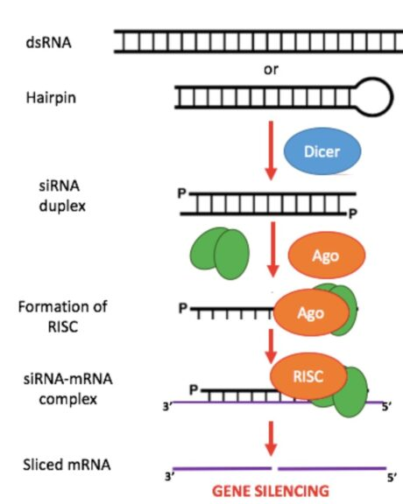
miRNA AND siRNA
Notes:
One of the earliest tools for gene silencing harnesses the cell's own small RNA
machinery. MicroRNAs (miRNAs) and small interfering RNAs (siRNAs) bind
complementary mRNA sequences, leading to degradation or translational re-
pression.
Imagine a message being intercepted and shredded before it can be read.
That is e ectively what these RNAs do to the mRNA transcripts. miRNAs
often act as ne-tuners, subtly adjusting gene expression, while siRNAs can
induce strong, speci c knockdown.

Slide 79
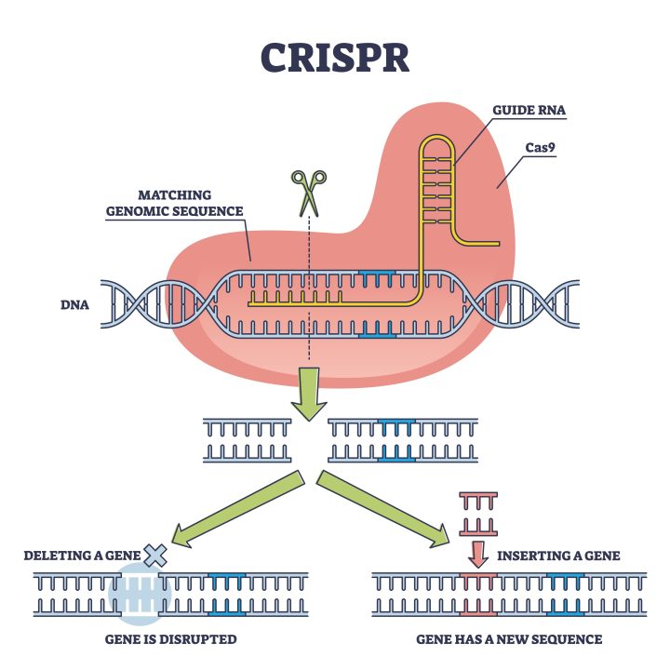
CRISPR KNOCKOUT AND CRISPRI/A
Notes:
The CRISPR-Cas9 system revolutionized gene perturbation. A guide RNA
directs Cas9 nuclease to a speci c DNA sequence, creating a double-strand
break that can disable a gene|a knockout. Variants such as dCas9 (nuclease-
dead Cas9) can repress (CRISPRi) or activate (CRISPRa) transcription without
cutting DNA.
CRISPR is akin to a programmable pair of molecular scissors, or a precision
dimmer switch: we can turn genes o , or dial their expression up or down.
This enables not only functional studies but also high-throughput screens that
explore thousands of genes simultaneously.
Consider the challenge: how do you ensure that Cas9 only cuts the intended
sequence? O -target e ects are a critical consideration in both experimental
design and computational prediction.

Slide 80
CRISPR KNOCKOUT AND CRISPRI/A
🛠️ Cas9 induces double-strand breaks for knockout
🔹 dCas9-KRAB for CRISPRi (repression)
⚡ dCas9-VP64 for CRISPRa (activation)
💻 Programmable gene perturbation
Notes:
The CRISPR-Cas9 system revolutionized gene perturbation. A guide RNA
directs Cas9 nuclease to a speci c DNA sequence, creating a double-strand
break that can disable a gene|a knockout. Variants such as dCas9 (nuclease-
dead Cas9) can repress (CRISPRi) or activate (CRISPRa) transcription without
cutting DNA.
CRISPR is akin to a programmable pair of molecular scissors, or a precision
dimmer switch: we can turn genes o , or dial their expression up or down.
This enables not only functional studies but also high-throughput screens that
explore thousands of genes simultaneously.
Consider the challenge: how do you ensure that Cas9 only cuts the intended
sequence? O -target e ects are a critical consideration in both experimental
design and computational prediction.

Slide 81
POOLED CRISPR SCREENS
📊 Library of sgRNAs targeting many genes
🧬 Selection based on phenotype
💻 NGS readout of guide abundance
⚡ Identify essential genes or pathways
Notes:
Pooled CRISPR screens allow genome-wide functional studies in a single ex-
periment. Millions of cells receive di erent guide RNAs, each targeting a dif-
ferent gene. After selection|such as survival under a stress or drug treat-
ment|sequencing identi es which guides were enriched or depleted, revealing
gene function.
This is conceptually similar to testing hundreds of software modules in par-
allel under di erent conditions to see which modules fail or succeed. Computa-
tionally, the challenge is mapping guide abundance back to functional e ects,
accounting for variability and noise in both delivery and cell proliferation.
Key design considerations include library coverage, multiplicity of infection,
and appropriate controls to distinguish true hits from experimental noise.

Slide 82
GUIDE RNA DESIGN ALGORITHMS
🛠️ Algorithms: CRISPR-DO, CHOPCHOP
⚠️ Predict potential off-targets
💻 Optimize efficiency and specificity
🔹 Consider PAM requirements
Notes:
The e ectiveness of CRISPR depends heavily on guide RNA (gRNA) design.
Algorithms predict on-target e ciency and minimize o -target binding by eval-
uating sequence context, PAM motifs, secondary structures, and genome-wide
similarity.
Popular tools use scoring functions, machine learning models, and some-
times deep learning to prioritize guides. This is similar to designing robust
search queries or queries in a distributed system: the goal is precision, avoiding
unintended matches.
As an IT-minded audience, think about scalability: how do you e ciently
scan an entire genome to predict potential o -target sites for thousands of can-
didate guides?

Slide 83
MAGECK, CRISPRESSO
🛠️ MAGeCK: differential sgRNA abundance analysis
💻 CRISPResso: indel quantification
📊 Identify essential genes or pathways
⚡ Statistical modeling of enrichment/depletion
Notes:
After a pooled screen, computational analysis determines which genes are func-
tionally signi cant. Tools like MAGeCK and CRISPResso analyze sequencing
data to quantify guide representation, normalize counts, and statistically iden-
tify enriched or depleted guides.
This is analogous to analyzing results from A/B tests or large-scale dis-
tributed experiments: normalization, error modeling, and multiple testing cor-
rection are critical. The insights obtained inform biological hypotheses and can
guide further experiments.
A question to ponder: how do we integrate results from multiple perturba-
tion types|siRNA, CRISPR knockout, CRISPRi/a|to build a coherent model
of gene function across di erent contexts?
With gene perturbation and silencing strategies understood, we are now
equipped to explore the broader picture of genomics integration|combining
multiple layers of genomic and epigenomic data to understand cellular function
at a systems level.

Slide 84
SYNTHETIC BIOLOGY OVERVIEW
🧬 Engineering biology using modular parts
🔹 Design, build, test cycles
💻 Computational models guide design
⚡ Goal: predictable, robust circuits
Notes:
Synthetic biology is the engineering side of biology|designing and construct-
ing new biological parts, devices, and systems. The eld combines molecular
biology, genetics, and computational modeling to create predictable behaviors
in cells.
Think of synthetic biology as software engineering for living systems. Just
as software engineers design modules and workows, synthetic biologists design
genetic modules with de ned inputs and outputs. The challenge is even greater
here: living systems are noisy, adaptive, and interconnected.
A key question: how can we design robust genetic systems that perform as
intended in such complex and dynamic environments?

Slide 85
PROMOTERS, ENHANCERS, RBS
📝 Promoters control transcription initiation
🧩 Enhancers modulate activity
🔹 RBS influences translation efficiency
💻 Modular parts for circuit construction
Notes:
At the foundation are genetic parts: promoters control when and where genes
are expressed; enhancers modulate transcription levels; ribosome binding sites
(RBS) a ect translation e ciency. Each part is akin to a function, parameter,
or interface in software.
Understanding these components allows us to mix and match modules to
achieve desired behaviors. For example, a strong promoter with a weak RBS
produces a di erent protein output than a weak promoter with a strong RBS.
Predicting these outcomes requires quantitative knowledge of gene regulation.
Consider: how might small changes in promoter or RBS strength propagate
through a circuit to create unexpected behaviors?

Slide 86
GENETIC CIRCUITS
⚡ Toggle switches: bistable states
⏱️ Oscillators: rhythmic gene expression
💻 Implemented with repressors/activators
🔹 Predictable behavior via modeling
Notes:
With these parts, we can build genetic circuits. A toggle switch, for example,
ips between two stable states based on inputs. Oscillators generate rhythmic
gene expression over time. These are the biological analogs of ip-ops and
timers in electronics.
Designing circuits requires careful consideration of feedback loops, delays,
and noise. Even minor di erences in part strength or cellular context can dra-
matically alter circuit behavior.
Think about this as designing a distributed system: timing, feedback, and
signal propagation all inuence system stability and performance.

Slide 87
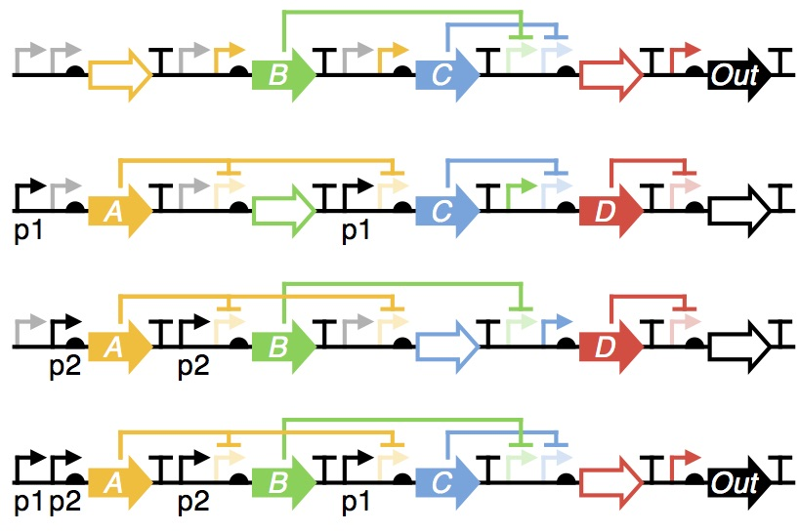
GENETIC CIRCUITS
Notes:
With these parts, we can build genetic circuits. A toggle switch, for example,
ips between two stable states based on inputs. Oscillators generate rhythmic
gene expression over time. These are the biological analogs of ip-ops and
timers in electronics.
Designing circuits requires careful consideration of feedback loops, delays,
and noise. Even minor di erences in part strength or cellular context can dra-
matically alter circuit behavior.
Think about this as designing a distributed system: timing, feedback, and
signal propagation all inuence system stability and performance.

Slide 88
CRISPR-BASED LOGIC CIRCUITS
🛠️ dCas9-based gene regulation
🔹 Build AND/OR logic gates
💻 Programmable and modular
⚡ Applications in synthetic networks
Notes:
CRISPR technology enables programmable logic circuits in cells. Using CRISPRi
(repression) and CRISPRa (activation), we can create AND, OR, NOT gates,
and even more complex logic circuits controlling gene expression.
Imagine building a cell that \computes" a response to environmental signals:
if input A AND input B are present, produce protein X; if input C, shut down
gene Y. This is the essence of CRISPR-based logic circuits.
From a computational perspective, designing these circuits requires mapping
molecular interactions to logical functions, predicting outputs, and accounting
for stochastic variability.

Slide 89
COMPUTATIONAL MODELING OF CIRCUITS
📊 Ordinary Differential Equations model dynamics
⚡ Stochastic simulations capture noise
💻 Predict circuit behavior before experiments
🔹 Integrate with experimental data
Notes:
To predict circuit behavior, we use computational models. Ordinary di eren-
tial equations (ODEs) model continuous dynamics of gene expression, while
stochastic models capture probabilistic uctuations in molecular interactions.
These models allow us to simulate the system before physically constructing
it, saving time and resources. It is similar to testing software in a virtual
environment before deployment to production.
Question to ponder: how do we choose between deterministic and stochastic
models for a given circuit? When is noise not just a nuisance, but a functional
feature?

Slide 90
SIMULATION TOOLS: CELLDESIGNER, COPASI
🛠️ CellDesigner: visual modeling of pathways
💻 COPASI: kinetic and stochastic simulations
📊 Analyze steady states and dynamics
⚡ Useful for teaching and design validation
Notes:
Several software tools support circuit modeling and simulation. CellDesigner
provides a graphical interface for constructing and visualizing biochemical net-
works. COPASI allows quantitative simulation, parameter tting, and sensitiv-
ity analysis.
These tools are analogous to integrated development environments (IDEs)
in software engineering, providing both design and debugging capabilities. They
allow iterative re nement of circuits, bridging the gap between computational
prediction and experimental implementation.

Slide 91
PART LIBRARIES AND STANDARDS
🗂️ BioBricks: modular standardized parts
🏆 iGEM registry of parts and projects
📄 SBOL: data standard for sharing designs
💻 Facilitates reproducible synthetic biology
Notes:
To facilitate sharing and standardization, synthetic biology uses part libraries
and formal speci cations. BioBricks are standardized DNA parts. The iGEM
competition has popularized modular assembly and community-driven innova-
tion. SBOL (Synthetic Biology Open Language) provides a standardized way
to describe genetic designs.
Standardization ensures reproducibility, interoperability, and scalability. It
is akin to using widely accepted APIs or code libraries in software development.

Slide 92
APPLICATIONS
🧪 Biosensors detect environmental or cellular signals
💊 Therapeutics: engineered cells or pathways
🔹 Synthetic gene networks for research
💻 Integrates computation and wet-lab design
Notes:
Finally, synthetic biology has exciting applications: biosensors detect environ-
mental or cellular signals; synthetic circuits can produce therapeutic proteins
on demand; and engineered networks allow cells to perform computations or
decision-making tasks.
This is where engineering meets biology: we can design living systems that
respond predictably, interface with medical technologies, or sense and respond
to environmental cues.

Slide 93

SUMMARY
🧬 Genomics: sequencing, assembly, pangenomics
📊 Variation & GWAS: tools and pipelines
🧪 Epigenomics: methylation and chromatin
⚡ Functional genomics & synthetic biology

